Slide 1
Limited English Monarchy, Enlightenment and Scientific Revolution, The French Revolution; Chapters 5, 6, & 7
Mrs. Tucker
World History
Victor Valley High School

Slide 2
Vocabulary Front-Load – Frayer Method
Salon
Neoclassical
Despotism
Ideology
Estates
Serf
Philosophes
Coup d’état
Hundred Days
emigre
Sans-culotte
Jacobin

Slide 3
Define the terms using the Frayer Method
Your Definition Draw picture/graphic
to recognize the term.
TERM
Example/Synonym/ Non Example / Characteristic Antonyms
Non-Characteristics

Slide 4
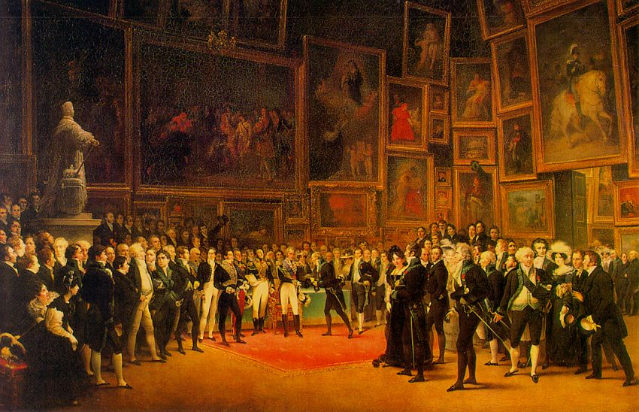
Salon
Events run by women
Where philosophers, artists
Scientists, and intellects met
To discuss idea;
Large gathering place Private or One-on-
to talk about ideas; One;

Slide 5
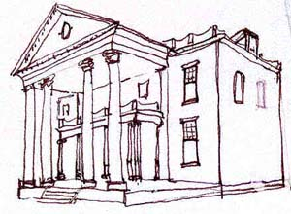
Neoclassical
Revival of ancient Greek
and Roman styles, usually
Art, architecture, and
Philosophy;
Modern renderings of Brand new styles
ancient styles;

Slide 6
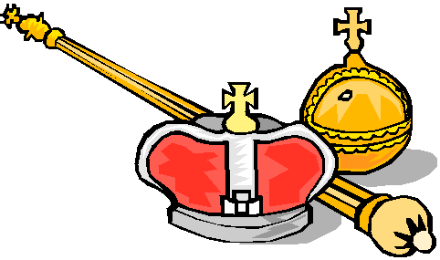
Despotism
Ruler with absolute
Power, tyranny, control;
Tyranny Democracy

Slide 7
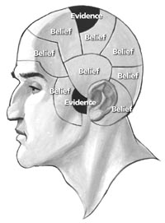
Ideology
doctrine, myth, or belief
that guides an individual,
Social movement, institution,
or class;
Creed, ideas, outlook no beliefs, skeptism; atheism;

Slide 8
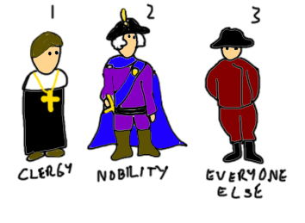
Estates
Social classes in France
Before French Revolution;
1st Estate-Clergy, 2nd Estate-
Nobilty, andThird Estate-
Everyone else;
Class no defined class

Slide 9
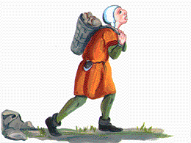
Serf
State of servitude to
A lord, attached to the
Land;
Slave Freeman

Slide 10
Philosophes
French intellectual or
Social philosopher in
The 18th century;
Voltaire Louis XVI
Montesquieu Marie Antoinette
Rosseau Cardinal Louie deRohan

Slide 11
Coup d’état
Sudden seizure of
Political power in
A nation;
Big Win Forfeit, loss, surrender

Slide 12
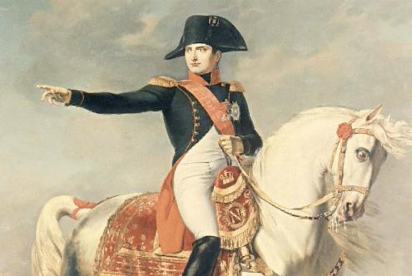
Hundred Days
The last 100 days of
Napoleon ending with
His defeat at Waterloo;
Last attempt; Giving Up without
Last hurrah; a fight;

Slide 13
émigré
A person who leaves
His Native country for
Political Reasons;
Expatriate; refugee; Native; Nationalist;

Slide 14
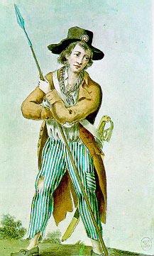
Sans-culotte
Radical Parisian workers &
Shopkeepers_-wanted a
Greater voice in government,
Lower prices, & end to food
shortages;
Radical; Conservative;

Slide 15
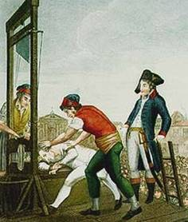
Jacobin
Members of the most
Radical group during
The French Revolution
Led by Robespierre and
Promoted Reign of Terror;
Extreme Radical Ultra Conservative;

