Slide 1
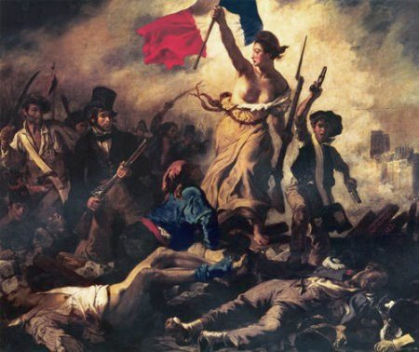
Unit 2 Revolutions
Mrs. Tucker
World History
Victor Valley High School

Slide 2
Main Ideas
Absolutism - Russia
Constitutional Monarchy - England
Scientific Revolution
The Enlightenment
The Enlightenment Spreads
The American Revolution
The French Revolution
Reform and Terror
Napoleon
The Congress of Vienna

Slide 3
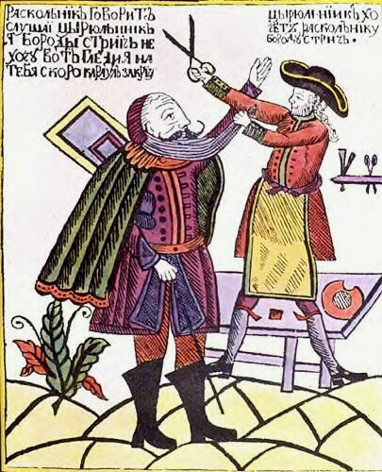
Russia - Absolutism
Russia – model after the West or Focus on Traditional Russian Culture?

Slide 4
Russia
Ivan the Terrible, 1533 – fought against boyars (landowning nobles);
Added lands,
Gave Russia a code of laws;
Ending reign with violence; “Bad Period;”
Romanov Dynasty – Peter the Great
Russia is a land of boyar and serfs – Mongol rule cut Russia off from Renaissance and Age of Exploration;
Russian Eastern Orthodox Religion vs Catholic or Protestant;
Peter visits the west in 1697—first Czar to travel to the West and tried to implement reforms;

Slide 5
Peter the Great’s Westernization
Brought Russian Orthodox Church under state control, Holy Synod runs church under his direction;
Reduced powers of great landowners;
Modernized army by hiring European officers who trained soldiers with European tactics and weapons;
Imposed heavy taxes to fund new army;

Slide 6
Peter the Great’s Westernization
Introduced Potatoes – became staple of diet;
Started first Russian newspaper;
Raised status of Women – attend social gatherings;
Ordered nobles to give up traditional dress and cut their beards;
Opened a school off navigation; and schools for arts and sciences;

Slide 7
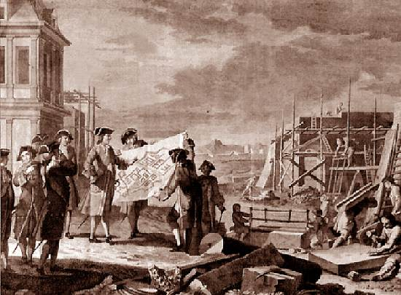
Peter the Great; St. Petersburg

Slide 8
Window of the West
Built St. Petersburg on the Baltic Sea ;
Swampy area was unhealthful; Many serfs died building the city;
Ordered nobles to leave Moscow and settle there;
Seaport allowed for easier travel to Europe;
Peter westernized and reformed culture and government of Russia;
Russia modernized and became a European power;

Slide 9
Parliament Limits Monarchy
Stuart Dynasty
Scottish king, James Stuart ascends English throne when Elizabeth I died without a heir;
James I struggles with Parliament over money;
James offends the Puritan members of Parliament;

Slide 10
James I Charles I

Slide 11
Parliament Limits Monarchy
Charles I is fighting war with Spain and France;
Continually asks Parliament for money and when they refuse dissolves it;
Parliament forced Charles to sign a document, “Petition of Right” agreeing to:
Not imprison subjects without due cause;
Not levy taxes without Parliament’s consent;
House soldiers in private homes
Impose martial law in peace;
After agreeing to this, he ignored it;

Slide 12
Parliament limits Monarchy
The Petition of Right set the idea that the law was higher than the king;
Contradicted theories of absolute monarchy;
Charles dissolved Parliament in 1629 and did not call it back;
Imposed all kinds of fees and fines;
Offended Puritans by upholding Anglican Church practices, and Scots by trying to force them to accept Anglican prayer book;
Scots rebel against England and Charles needs money to fight a war with Scots;

Slide 13
Parliament Limits Monarchy
Charles must call Parliament to get money for his war;
In 1641 Parliament passed laws to limit royal power;
When Charles tries to arrest Parliament’s leaders, a mob rages outside the Palace;
Charles heads North where he has supporters and raises an army;

Slide 14
English Civil War

Slide 15
English Civil War – 1642 - 1649
Those loyal to Charles – Royalists or Cavaliers;
Those loyal to Parliament – Puritans/Roundheads;
Oliver Cromwell leads Roundheads – New Model Army;
Charles is captured and tried for treason against Parliament, sentenced to death and executed - 1649;

Slide 16
Cromwell Rules
Abolished monarchy and House of Lords;
Established commonwealth; and a republican form of government;
First written constitution drafted in 1653;
Puritan Morality- no theater, sporting events, and dancing;
Religious toleration for all Christians EXCEPT Catholics; Jews allowed to return;

Slide 17
Oliver Cromwell Charles II

Slide 18
Restoration
Cromwell dies; England sick of military rule, votes in 1659 to have oldest son of Charles I to rule England;
Charles II Reigns;
Habeas Corpus
Charles died with no legitimate heir; his brother James II, who is Catholic, inherits throne;

Slide 19
Glorious Revolution
James II offends subject with Catholicism, violating English laws, appointing Catholics to high office, and dissolving Parliament;
Parliament supports James daughter, Mary, and her husband, William of Orange in the Netherlands, to overthrow James;
Bloodless overthrow is called “The Glorious Revolution”

Slide 20
Limits on Monarch’s Power
William and Mary have a constitutional monarchy;
Reforms included:
English Bill of Rights, 1689 – limits royal power to not
Suspend Parliament’s laws;
Levy taxes without specific grant from Parliament;
Interfere with freedom of speech in Parliament;
Penalize citizens who petition king about grievances;

Slide 21
William and Mary

Slide 22
Limits on Monarch’s Power
No ruler could rule without consent of Parliament and Parliament could not rule without consent of Monarch;
In 1700s Cabinet develops and over time becomes center of power and policymaking;
Majority party in Parliament heads cabinet and is called prime minister;

Slide 23
Scientific Revolution
Geocentric Theory – earth-centered view of universe – 4th century BCE – Aristotle;
Ptolemy expanded theory in 2 CE
Scientists expanded thinking in 1500s challenging ideas of ancient thinkers and church;
Scientific Revolution - new way of thinking about the world based on careful observation and challenging accepted beliefs;

Slide 24
Scientific Revolution
Heliocentric Theory – sun centered theory;
Copernicus’s theory – On the Revolutions of the Heavenly Bodies – published on deathbed;
Galileo supports Copernican theory, Dialogue Concerning the Two Chief World Systems, forced to recant after standing trial before Inquisition;
Scientific Method – new approach – logical procedure for gathering and testing ideas;

Slide 25
Scientific Theory

Slide 26
Scientific Revolution
Isaac Newton
Force ruled motion of planets and all matter on earth and in space;
Combined work of Copernicus, Kepler, and Galileo;
Law of universal gravitation;
Principia Mathematica

Slide 27
Changing Idea: Scientific Method
Old Science
New Science
Scholars generally relied on ancient authorities, church teachings, common sense, and reasoning to explain the physical world.
In time, scholars began to use observation, experimentation, and scientific reasoning to gather knowledge and draw conclusions about the physical world.

Slide 28
Scientific Revolution Spreads
Scientific Instruments
First Microscope – Zacharias Janssen, Dutch eyeglass mater 1590;
Anton van Leeuwenhoek – 1670 - microscope to observe bacteria and examined red blood cells;
Evangelista Torricelli – 1643 - developed first mercury barometer;
Gabriel Fahrenheit 1714 – first thermometer – freezing at 32°;
Anders Celsius – 1742 – another mercury thermometer – freezing at 0°;

Slide 29
Medicine and the Human Body
Andreas Vesalius – dissected human corpses, 1543;
Edward Jenner, vaccine to prevent smallpox – late 1700s;
Robert Boyle – use of scientific method Chemistry – founder of modern chemistry;
Boyle’s Law – matter made up of smaller primary particles – joined together in different ways;
Explains how volume, temperature and gas affect each other;

Slide 30
Enlightenment
Thomas Hobbes
Leviathan, 1651
Humans naturally selfish and wicked without government there would be war – “life solitary, poor, nasty, brutish, and short;”
Absolutist;
Believed in Divine Right;
John Locke
NATURAL LAW
Self-Government
All men are both free and equal
Two Treatises on Government
Natural Rights
Life, Liberty, and Property;
Government’s power comes from consent of people;

Slide 31
Enlightenment Thinkers
Jean Jacques Rousseau
Social Contract
Government freely formed by the people;
“Man is born free, but everywhere he is in chains.”
Emilé
Baron de Montesquieu
Advocate of British Constitutional Monarchy;
Separation of Powers
On the Spirit of the Laws - 1748

Slide 32
Philosophes
Reason – Truth discovered through reason/logical thinking;
Nature – Natural good and reasonable;
Happiness – rejected idea that people find joy in the hereafter and urged people to seek well-being on earth;
Progress – philosophes stressed society and humankind could improve;
Liberty – philosophes called for liberties that the English won in Glorious Revolution and Bill of Rights;

Slide 33
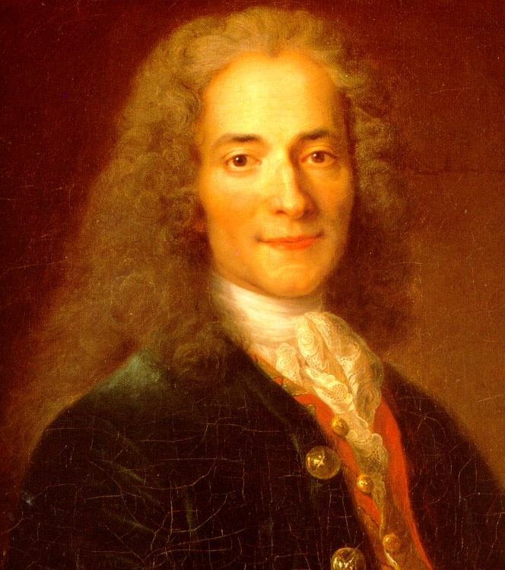
Voltaire
“I do not agree with what you have to say, but I will defend to the death your right to say it.”
François Marie Arouet
Published over 70 books;
Sent to jail but never stopped fighting for tolerance, reason, freedom of religious belief, and freedom of speech.
Gadfly;

Slide 34
Enlightenment Thinkers
Cesare Bonesana Beccaria
Laws existed to preserve social order
Criticized common abuses of justice;
Speedy trial;
No torture;
Ideas influenced criminal law reformers in Europe and North America;
Adam Smith
Father of Capitalism;
Wealth of Nations – 1776
Laissez Faire
Invisible Hand;

Slide 35
Women in the Enlightenment
Salons
Run by Women;
Spread the Enlightenment Ideas;
Mary Wollstonecraft
A Vindication of the Rights of Woman – 1792
Disagreed with Rousseau that women’s education should be second under mans;
Emilie du Chatelet
Aristocrat – mathematician and physicist;
Translated Newton’s work from Latin into French;

Slide 36
Enlightenment
Jonathan Swift
Gulliver’s Travels – 1726
Voltaire;
William Hogarth
Canvassing for Votes
Candide – 1759

Slide 37
Legacy of Enlightenment
Challenged ideas;
Scientific method – test everything;
Success of Scientific Revolution - Reason and Logic can be applied to all things;
Questioning Church and Religion;

Slide 38
Enlightenment and Revolution, 1550 - 1789
Scientific Revolution | Enlightenment | Spread of Ideas | American Revolution
Heliocentric theory challenges geocentric theory. | People try to apply the scientific approach to aspects of society. | Enlightenment ideas appeal to thinkers and artists across Europe. | Enlightenment ideas influence colonists.
Mathematics and observation support heliocentric theory. | Political scientists propose new ideas about government. | Salons help spread Enlightenment thinking. | Britain taxes colonies after French and Indian War.
Scientific method develops. | Philosophes advocate the use of reason to discover truths. | Ideas spread to literate middle class. | Colonists denounce taxation without representation.
Scientists make discoveries in many fields | Philosophes address social issues through reason | Enlightened despots attempt reforms. | War begins in Lexington and Concord.

Slide 39
The French Revolution and Napoleon, 1789-1815
Economics – Economic and social inequalities in the Old Regime helped cause the French Revolution
The revolutionary government of France made reforms but also used terror and violence to retain power.
Napoleon Bonaparte, a military genius, seized power in France and made himself emperor.
Napoleon’s conquests aroused nationalistic feelings across Europe and contributed to his downfall.

Slide 40
The Ancien Regime - Estates – Social Classes
First Estate
Clergy
about 1 % of population
owned 10% of land
Provided education and relief services to poor;
Second Estate
Nobility
about 2% of population
owned 20% of land
paid almost no taxes;
Third Estate
Everyone else
97% of population;
Several economic groups made up the third estate
Bourgeoisie (middle class),
Urban Workers,
Peasants
Heavily taxed

Slide 41
Causes of the French Revolution
Enlightenment Ideas
Rousseau, Montesquieu, Locke, and Voltaire;
Success of American Revolution;
Liberty, Equality, Fraternity;
Economic Troubles
Heavy Tax Burden;
Bad weather – Crop Failures;
High Cost of Living;
Shortage of grain – bread;
People facing starvation;
Excessive Debt
Supporting the Americans in the Revolution;
Excessive spending by Louis XVI and Marie Antoinette;
Inherited debt from previous kings (Louis XIV)
Versailles
Weak Leadership
Louis XVI was indecisive leaders;
Let things drift and did not pay attention to his advisors;
Marie Antoinette disliked by French – Austrian – “Madame Deficit.;”
Did not cut expenses;
Imposed more taxes on already over taxed third estate;

Slide 42
Debt in France
Urban Commoner’s Budget:
Food 80%
Rent 25%
Tithe 10%
Taxes 35%
Clothing 20%
TOTAL 170%
King’s Budget:
Interest 50%
Army 25%
Versailles 25%
Coronation 10%
Loans 25%
Admin. 25%
TOTAL 160%

Slide 43
National Assembly
Estates General
Clergy – 1 vote
Nobles – 1 vote
Third Estate – 1 vote
The Clergy and Nobles sided together for all votes against Third Estate;
Emmanuel-Joseph Seiyès,
Dramatic speech to the Estates General “Who is the Third Estate? Everything!”
Suggested Third Estates delegates name themselves the National Assembly – pass laws and reforms;

Slide 44
The Suggested Voting Pattern: Voting by Estates
Clergy
1st Estate
1
Aristocracy
2nd Estate
1
1
Commoners
3rd Estate
Louis XIV insisted that the ancient distinction of the three orders be conserved in its entirety.

Slide 45
Tennis Court Oath and Storming the Bastille
June 17, 1789 – Third Estate vote to establish National Assembly;
Three days later, they are locked out of their room;
They break into an indoor tennis court, and pledge to stay until they draw up a new constitution;
This pledge is known as, “The Tennis Court Oath.”
Rumors flew that Louis was going to use military force to dismiss National Assembly;
On July 14, 1789, a mob looking for guns and ammunition storms the Bastille prison.
They seize control, free the 7 prisoners, and tear the building down;
Fall of the Bastille – start of the French Revolution;

Slide 46
The Tennis Court Oath

Slide 47
Great Fear
In the summer of 1789, a rumor that nobles were going to hire outlaws to terrorize peasants spread in the countryside;
Peasants armed themselves and broke into nobles’ manners and destroyed the old legal papers that bound them to pay feudal dues or burned down manors.
October, 1789, thousands of Parisian women rioted over rising cost of bread;
Armed with knives and axes, they marched to Versailles, killed the guards, and stormed the palace.
They demanded the King and Queen to return to Paris;

Slide 48
National assembly Reforms France
Swept away feudal privilege – all estates equal;
The Declaration of the Rights of Man and of the Citizen.
All men are born and remain free and equal in rights
Liberty, property, security, and resistance to oppression;
Equal justice, freedom of speech and freedom of religion;
Liberty, Equality, and Fraternity;
State Controlled Church;
Assembly took over Church lands; church priests elected and paid as state officials;
Church lost land and political independence;
Louis XVI and Marie Antoinette try to flee – recognized near the border and returned as traitors;

Slide 49
Divisions Develop
Arguments over new constitution
Limited Monarchy – 1791
Legislative Assembly – create laws, approve or reject declarations of war; king had executive power to enforce laws;
Different factions split France;
Émigrés – nobles and other – fled France to try to undo Revolution and restore Old Regime.
Sans-Culottes – working class – didn’t wear fancy knee-length pants – didn’t have regular role in assembly – used ways to exert their influence.

Slide 50
War and Execution
France at War
Monarchs and nobles in Europe are afraid the ideas of the French Revolution will spread to their countries.
Austria and Prussia urge French to restore Louis to position of Absolute Monarch
French Legislative Assembly declares war on Austria and Prussia in April 1792.
Prussian forces advancing on Paris threatened to destroy Paris if revolutionaries harmed royal family.
August 10, 20,000 storm the palace and imprison Louis, Marie Antoinette and their children.
September Massacres
Fearing supporters of the king would break out of prison and take control of the city, mobs raided prisons, murdering over 1,000 prisoners.

Slide 51
War and Execution
Legislative Assembly set aside the Constitution of 1791, deposed the king, dissolved the assembly, called for election of a new legislature.
New body, National Convention takes office on September 21.
It abolished monarchy
Declares France a republic;
Adult male citizens get right to vote and hold office;
Women were not given the right to vote;

Slide 52
War and Execution
Jacobins take control – Jean-Paul Marat.
Marat – newspaper called L’Ami du Peuple (Friend of the People) wrote editorials about death to those who supported the king;
Georges Danton, lawyer, talented and passionate speaker – devoted to rights of the poor of Paris;
National Convention reduced Louis XVI from a king to a common citizen and prisoner.
Radical Jacobins tries Louis for treason and sentences him to death by a close vote;
Louis is guillotined on January 21, 1793;

Slide 53
War and Execution
France won stunning victorys against Austria and Prussia at the Battle of Valmy;
Great Britain, Holland, and Spain joined forces against France as well;
Convention orders draft of 300,000 French citizens between 18-40;
By 1794, French Army is 800,000 large and includes women;

Slide 54
Reign of Terror
Maximilien Robespierre Assumes Control in early 1793;
Robespierre set out to build a “republic of virtue” by wiping out France’s past.
Change calendar
Closed churches;
Robespierre head of the Committee of Public Safety;
Governs France as a dictator;
Period of his reign – Reign of Terror
The Committee of Public Safety – protect the Revolution from enemies;

Slide 55
Reign of Terror
“Enemies” tried in morning and guillotined in the afternoon;
Justified terror saying it enabled French citizens to be true to the ideals of the Revolution;
Many revolutionaries were tried and executed for being less radical than Robespierre;
Georges Danton executed;
Marie Antoinette executed;
40,000 executed during Terror;
85% were peasants or members of the urban poor or middle class – Third Estate;

Slide 56
End of Terror
In July, 1794, some members of the National Convention turned on Robespierre, arrested, tried and he is sent to the guillotine;
People were tired of the terror, going prices for bread;
In 1795 moderate leaders in National Convention draft a new government – third since 1789;
Places power in hands of middle class
Government has a two-house legislature, and a 5 man executive body – The Directory;
This gave the country a period of order;
General commanding France’s armies – Napoleon Bonaparte;

Slide 57
Napoleon Bonaparte
Napoleon, from Corsica, 5’4” tall;
Recognized as military genius;
When royalist rebels marched on National Convention in 1795, Napoleon was told to defend delegates, and he did, and they fled, making him the savior of the French Republic;
1796 the Directory appointed Napoleon to lead the French army against Austria and Sardinia.
Napoleon crossed the Alps and won series of remarkable victories;
Napoleon led an expedition to Egypt which was not as successful;
Napoleon returns to Paris in 1799 when Directory is in power;

Slide 58
Coup de’État
In November, 1799 Napoleon and troops surrounded National Legislature and drove out most of its members;
Rest of members voted to dissolve Directory and established three consuls – one of whom was Napoleon
Napoleon took title of first consul and assumed powers of a dictator;
France was still at war with Britain, Austria, and Russia but signed a truce in 1802;
Europe is at peace for the first time in ten years;

Slide 59
Napoleon Rules France
Napoleon starts out as constitutionally chosen leader of a free republic;
Plebiscite (vote of the people) approves new constitution;
Desperate for strong leadership – people vote overwhelmingly for the constitution and power to Napoleon as First Consul;
Napoleon keeps many changes that came with the revolution;
Supported laws to strengthen central government;
Set economy on solid footing;
Set up efficient system of tax collection;
Established national banking system;
Took steps to end corruption and inefficiency in government
Brought untrained officials
set up lycées (government-run schools) for all male students;

Slide 60
Napoleon Rules France
Concordat – agreement with Pope Pius VII that established new relationship between Church and State;
Recognized influence of Church but rejected its control in national affairs;
Concordat gained Napoleon support of organized church and majority of the French people;
Napoleonic Code
Uniform set of laws
Eliminated many injustices;
Limited liberty and promoted order and authority over individual rights;
Restored slavery in French colonies in Caribbean;
Based on Roman Civil Law;

Slide 61
Napoleon’s Empire
Napoleon wanted to control not only France but the rest of Europe and French holdings in the North America and the Caribbean;
After losing the battle in Haiti to take back control, Napoleon decides to cut his losses in America;
Louisiana Purchase for $15 Million to Thomas Jefferson – 1803;
Napoleon annexed Austrian Netherlands and parts of Italy to France, set up puppet government in Switzerland;
Britain persuades Russia, Austria, and Sweden to join together against France;
Napoleon does well winning battles. Battle of Austerlitz in 1805;
Napoleon’s successes bring his empire to the largest since the Roman Empire;
Battle of Trafalgar – Napoleon loses this major battle off the Southwest coast of Spain against Horatio Nelson – British Admiral;
Battle destroyed French naval fleet and ensured supremacy of British for the next 100 years;

Slide 62
Continental System - 1806
Divorced his wife, Josephine because she could not give him a heir; Married Marie Louise or Austria who gave him a son, Napoleon II – who was named King of Rome;
Continental System
In 1806 Napoleon set up a blockade – forcible closing ports to prevent all trade and communication between Britain and the rest of Europe;
British smugglers brought cargo from Britain into Europe and Napoleon’s allies disregarded blockade;

Slide 63
Peninsular War - 1808
Peninsular War – 1808 Napoleon sent a force through Spain to get to Portugal to accept the Continental System;
Spanish King protested and Napoleon had him removed and put his own brother on the throne;
This enraged the Spanish and inflamed their nationalistic feelings and were afraid Napoleon would attack the church;
For six years Spanish peasant fighters, guerrillas, fought in small groups against the French troops;
Britain sent troops to aid the Spanish.
Napoleon lost 300,000 during the Peninsular War;
Nationalism – loyalty to one’s own country was a powerful weapon against Napoleon;

Slide 64
Napoleon’s Big Mistake
Invasion of Russia – 1812
Although Russia was an ally to Napoleon, he refused to stop selling grain to Britain;
Both France and Russia had designs on Poland;
Napoleon decides to invade Russia in June, 1812 with 420,000 soldiers;
Scorched-earth policy – as French troops advanced, Russian troops retreated and burned grain fields and slaughtered livestock to leave nothing for the advancing army.
Napoloen captures Moscow but the city is in flames.

Slide 65
Napoleon’s March on Russia
In October, Napoleon decides to head back to France;
Low temperatures, brutal conditions, and Russian attacks on the retreating army brought Napoleon’s grand army down to 10,000 soldiers;
Britain, Russia, Prussia, Sweden, and Austria join forces against him, capitalizing against his defeats;
Napoleon raises another army but the troops are untrained and ill prepared – faces armies outside Leipzig in October 1813 and is easily defeated;
By January, 1814, the allied armies were closing in on Paris, and he surrenders in April;
Napoleon is exiled to a tiny island – Elba off the Italian coast;

Slide 66
The Hundred Days
Louis XVI’s brother assumes throne as Louis XVIII but is unpopular;
Napoleon escapes Elba and on march 1, 1815 lands in France to joyous crowds and he marches on Paris;
Napoleon is emperor of France again within days;
European allies gather their armies;
The British army led by the Duke of Wellington battle with Napoleon at Waterloo, Belgium in June, 1915;
Napoleon attacks the British army and they hold their ground. Prussian troops arrive and together attack and Napoleon surrenders two days later;
This ends Napoleon hundred days of power.
Napoleon is banished to St. Helena – a remote Island in the Atlantic Ocean.

Slide 67
The Congress of Vienna
After the defeat of Napoleon, the European heads had a new goal or European order
Collective security
Stability for the continent
Balance of power
Lasting peace
Five great powers (Russia, Prussia, Austria, Great Britain, and France) met in Vienna n the winter of 1814-1815;
Prince Klemens von Metternich, foreign minister of Austria, was most influential;

Slide 68
Congress of Vienna
Metternich wanted stability of laws—never their change;
Metternich’s three goals:
Prevent French aggression – surround France with strong countries
Restore a Balance of Power;
Restore Europe’s royal familes to the thrones they held before Napoleon;
France and Britain – more liberal - constitutional monarchies;
Eastern Europe – more conservative – Absolute Monarchs;

Slide 69
Holy Alliance
In 1815, Czar Alexander I, Emperor Francis I of Austria, and King Frederick William III of Prussia signed Holy Alliance:
A pledge to base relations with other nations on Christian principles to combat forces of French Revolution;
Concert of Europe – Ensure nations would help one another if any revolutions broke out;
“When France sneezes, the rest of the world catches a cold”

Slide 70
Widespread Consequences of Congress of Vienna
When Napoleon deposed the King of Spain – Liberal Creoles (colonist born in Spanish America) seizes control of many colonies in Americas;
When Congress of Vienna restored the Spanish king to the throne, the royalist peninsulares (colonists born in Spain) tried to regain control, which led to revolts of Independence in Latin America;

Slide 71
Long-Term Consequences of Congress of Vienna
Nationalism spreads in Italy, Germany, Greece, and other areas that the Congress put under foreign control;
These Nationalistic feelings would later explode into revolutions;
New nations would be formed;
European colonies in the Americas responded to the power shit declaring their independence from Spain;
However, ideas of the basis of power and authority changed permanently as a result of the French Revolution;
More people saw democracy as the best way to ensure equality and justice for all;

