Slide 1
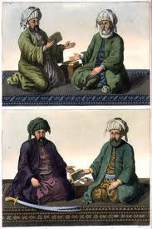
The First Four Caliphs
Mrs. Tucker
7th Grade World History/Honors
Cobalt Institute of Math and Science

Slide 2
The First Four Caliphs
Name - Abu Bakr
Relationship - Father-In-Law
Career - Merchant
Caliphate - A.D. 632-634
Accomplishments –
Lived Simply
Put down Various Revolts by Arabian Tribes
Treated Others Fairly
Restored Peace after the Death of Muhammad
Spread Islam to All of Arabia
Created Code of Conduct in War
Compiled the Quran Verses
Name – Umar
Relationship – Friend
Career – Merchant
Caliphate – A.D. 634 – 644
Accomplishments –
Spread Islam to Syria, Egypt.and Persia
Redesigned Government
Paid Soldiers
Held a Census
Made Taxes more Fair
Built Roads and Canals
Aided the Poor
Led an Exemplary Life

Slide 3
The First Four Caliphs, Continued
Name – Uthman
Relationship – Son-in-Law
Career – Merchant
Caliphate – A.D. 644 – 656
Accomplishments –
Spread Islam to Afghanistan and into the Eastern Mediterranean
Organized the Navy
Improved the Government
Built More Toads and Bridges
Distributed Text of the Quran
Name – Ali
Relationship – Cousin
Son-in-Law
Career – Soldier; Writer
Caliphate – A.D. 656 – 661
Accomplishments –
Treated Others Fairly
Reformed the Tax Collection and Other Government Systems
Spent Most of Caliphate Battling Muawiya, the Governor of Syria
Worked Hard to Spread Islam

Slide 4
