Slide 1
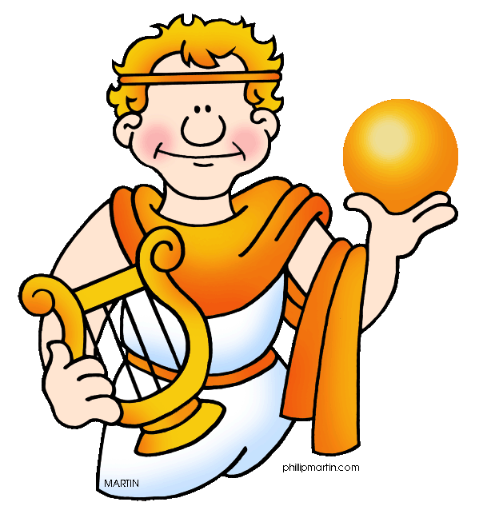
Roman and Greek Culture
Mrs. Tucker
7th Grade World History - Honors
Cobalt Institute of Math and Science

Slide 2
Roman Culture
Latin Language
Use of Arches and Domes
Statues are of Realistic People
Stoicism Toward Practicality
Little Emotion
Invented Concrete
Built Aqueducts
Made Vaults

Slide 3
Greek Culture
Greek Language
Statues are of Ideal Beauty
Stoicism toward Happiness Through Reason

Slide 4
Both Roman and Greek Culture
Many Gods and Goddesses
Use of Colonnades and Porches
Wrote Epics, Odes, Plays, and Satires
Interest in Science
Recorded Events of Their Own Civilization “History”

