Slide 1
Reigns of Yangdi & Wendi Venn Diagram
Mrs. Tucker
7th Grade World History/Honors
Cobalt Institute of Math and Science

Slide 2
Yangdi Wendi
Invasion of Korea had Failed
Supported Many Building Projects
Rebuilt the Great Wall of China after it had fallen into ruins
Created high taxes and forced labor
Built the grand canal and rebuilt China
Reunited China by Force in A.D. 581
Won Many Battles
Founded the Short Lived Dynasty called the Sui Dynasty

Slide 3
Both
Expanded Territory for the Chinese

Slide 4
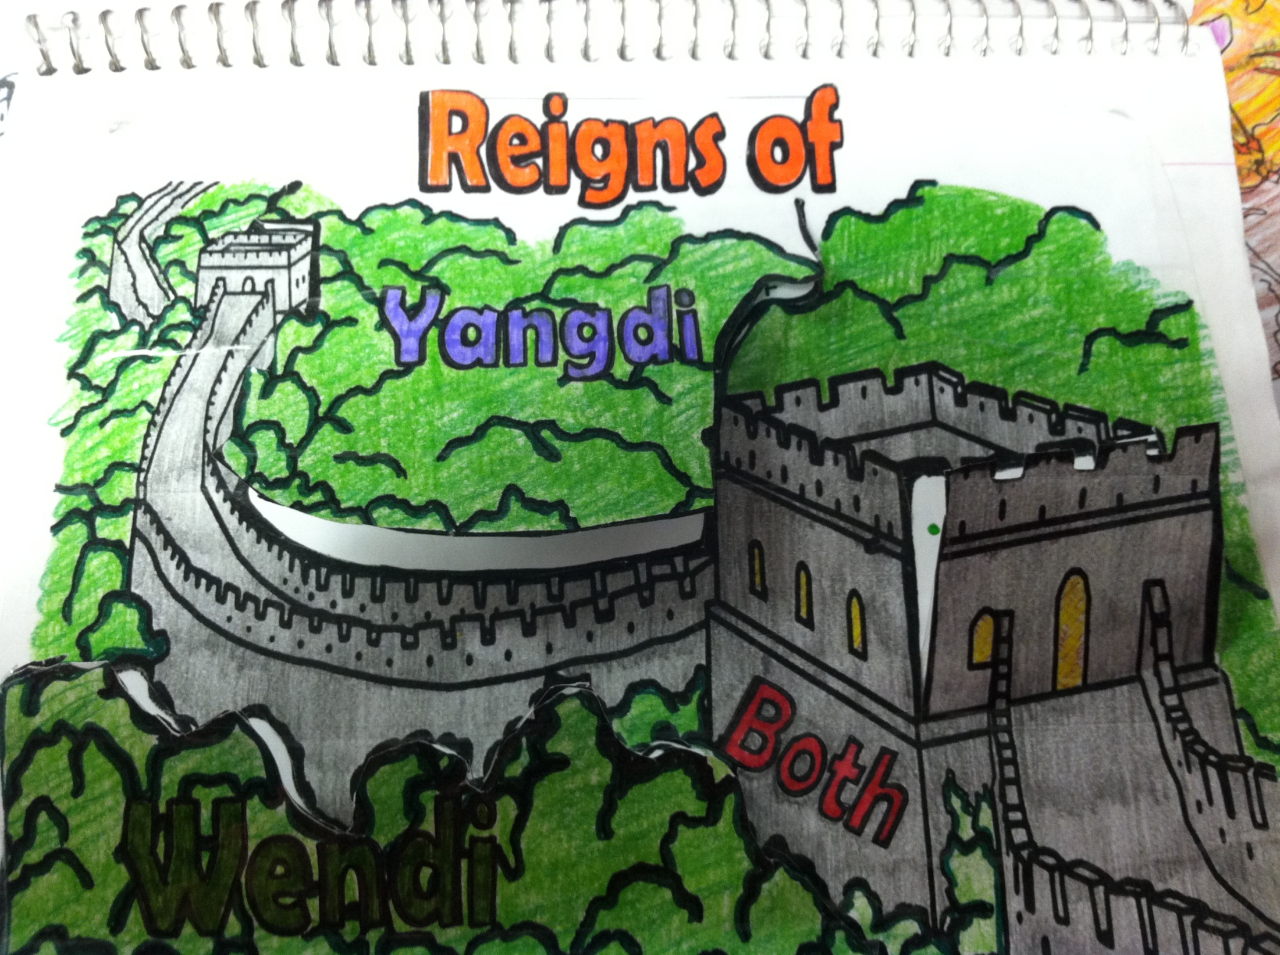

Slide 5
Yangdi Wendi

Slide 6
Both

