Slide 1
Hagia Sophia
Ms. Tucker
7th Grade World History/Honors
Cobalt Institute of Math and Science

Slide 2
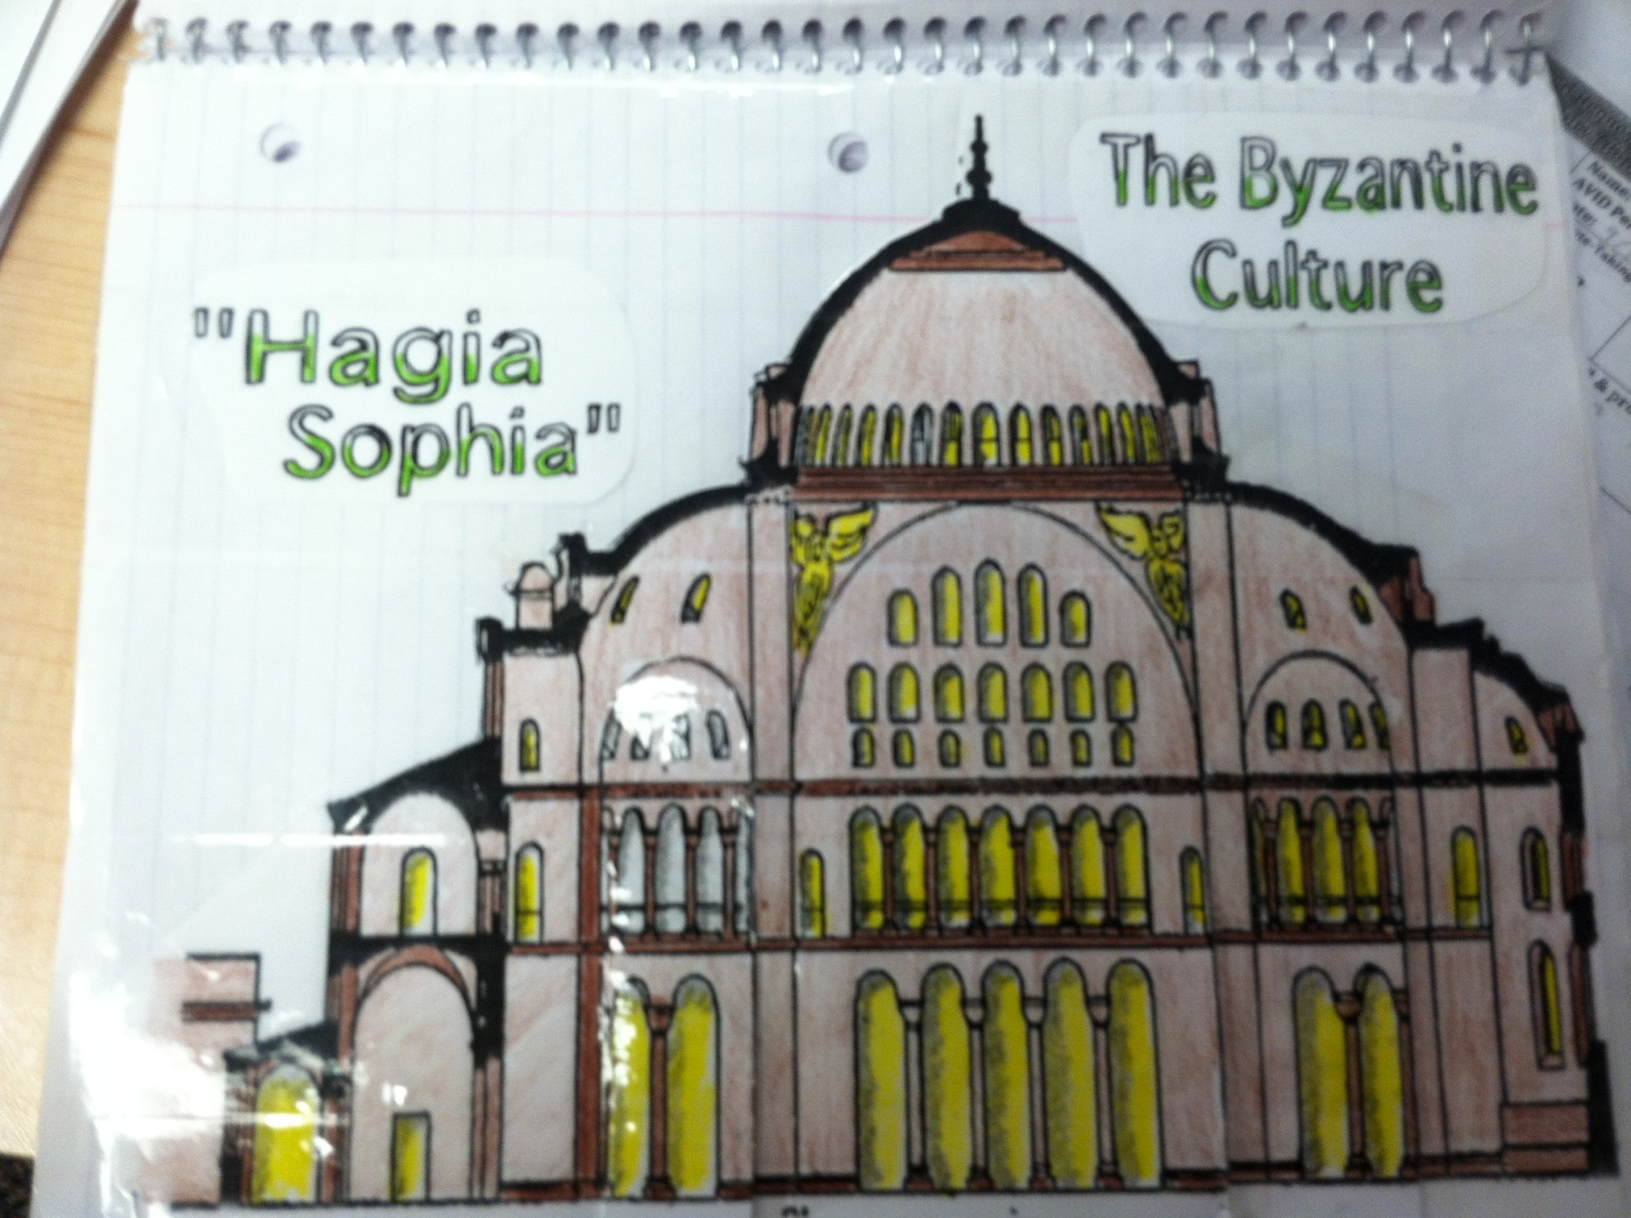

Slide 3
Women and Family Life
Center of Social Life
Government Stressed the Importance of Marriage & Family.
Women Not Encouraged to be Independent
Divorce Rare & Difficult
Under Theodora Women Became Education & Involved in Politics
Could Own Land
Some were Regents!

Slide 4
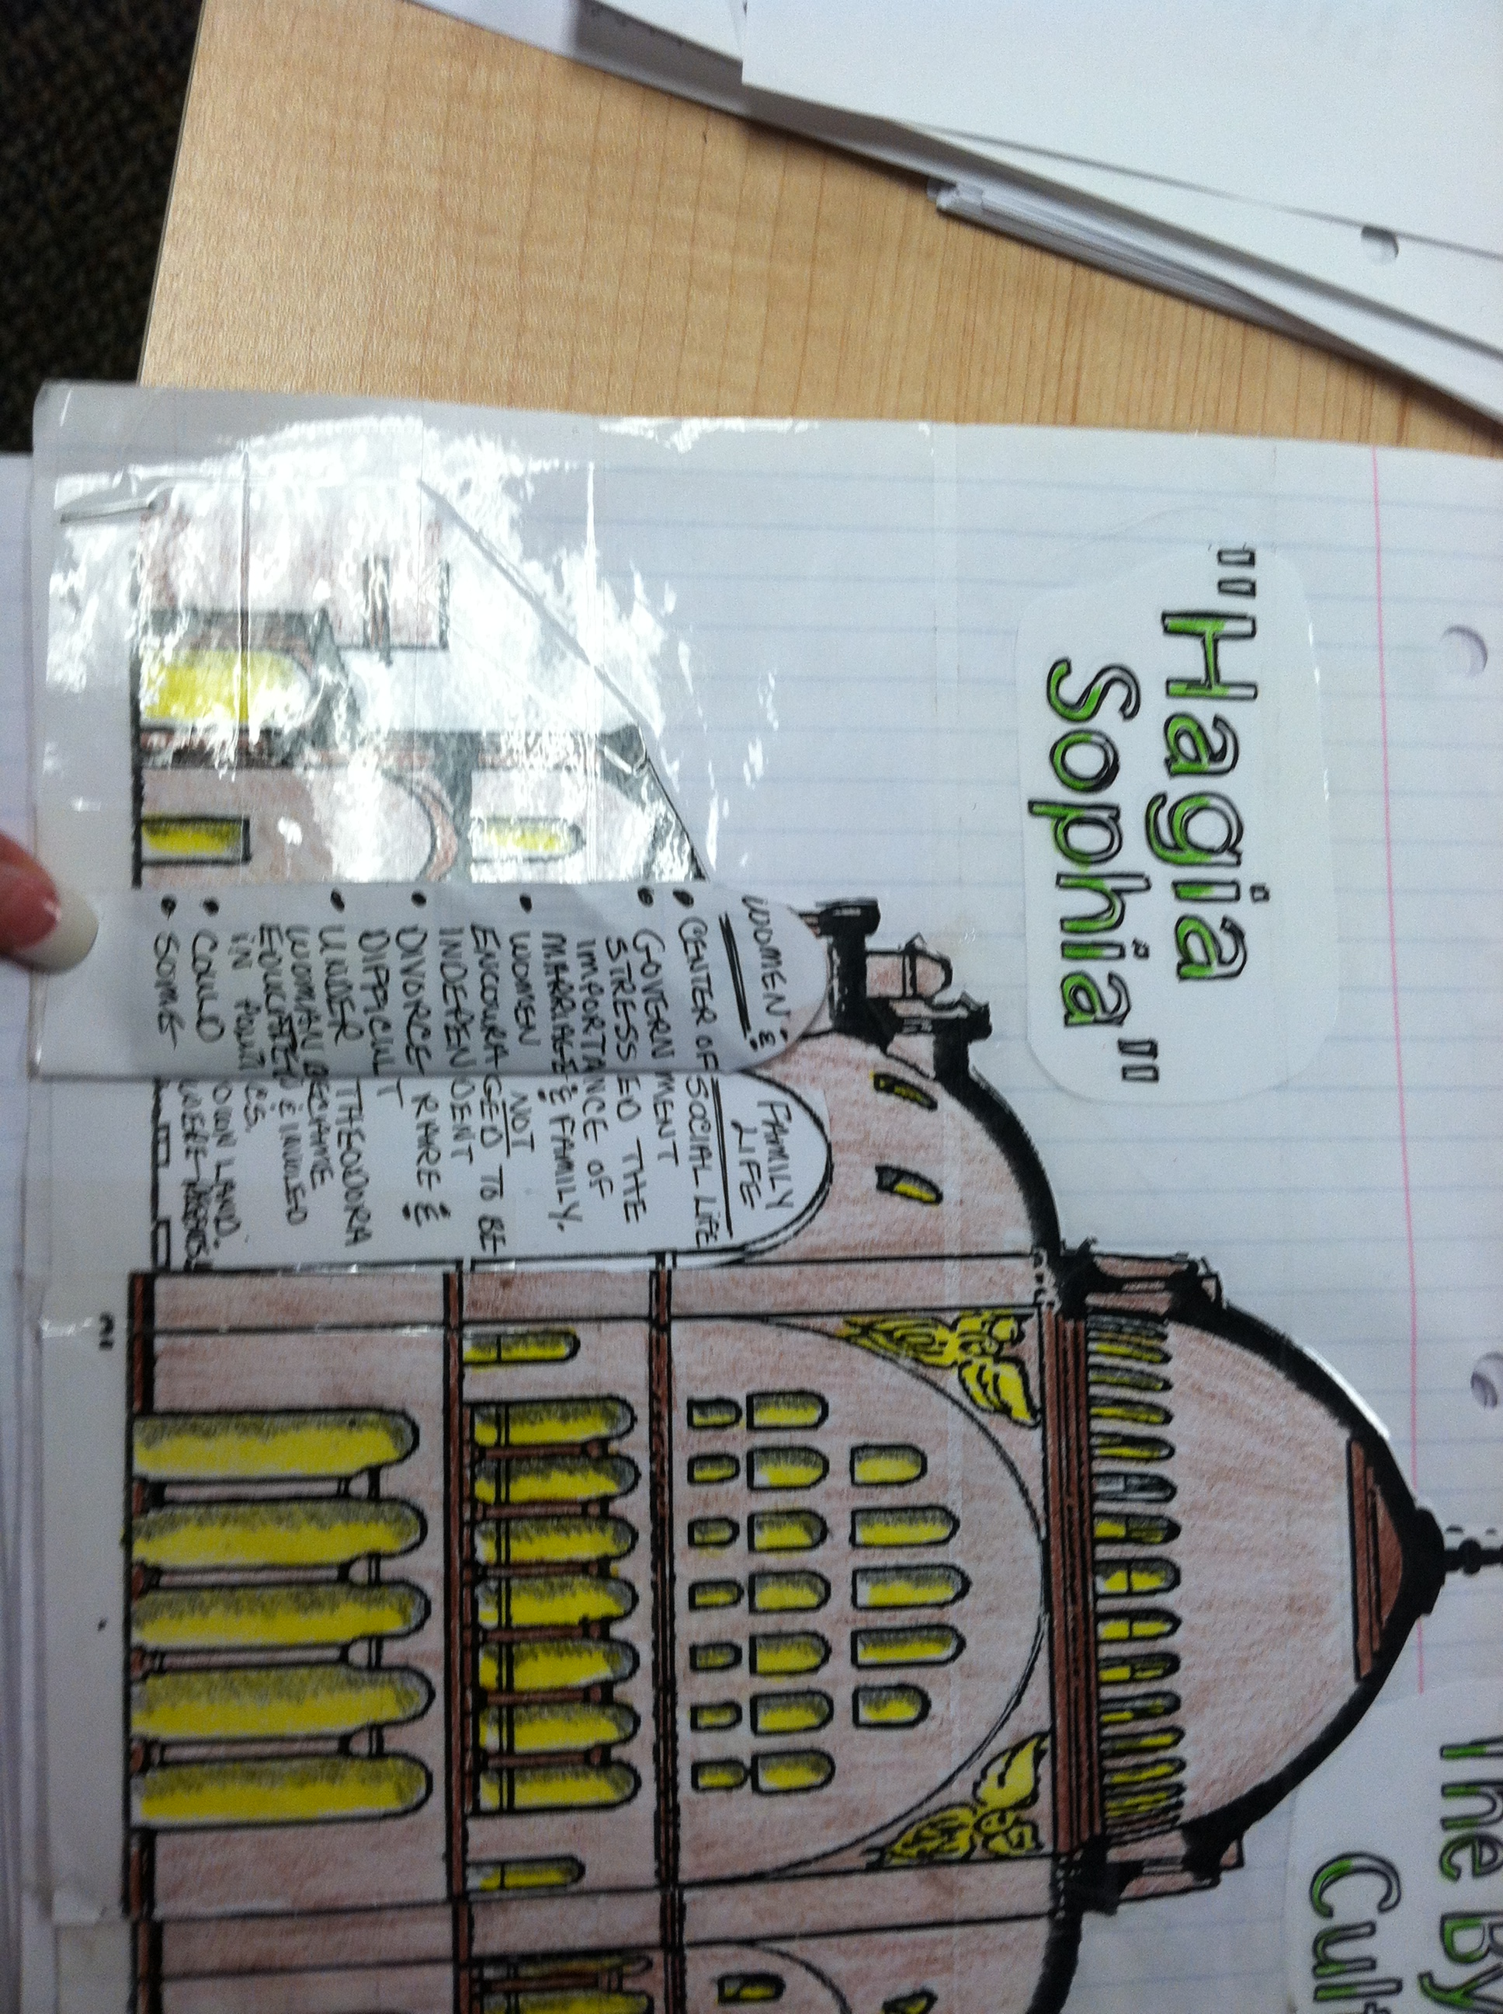

Slide 5
Education
Learning was Highly Respected
Government Supported Training of Scholars; Officials.
Boys Studied Religion, Medicine, Law, Math, and Grammar.
Girls Taught at Home.
Authors Taught About Religion.
Copies Ancient Greek/Roman Works to Pass on to us.

Slide 6
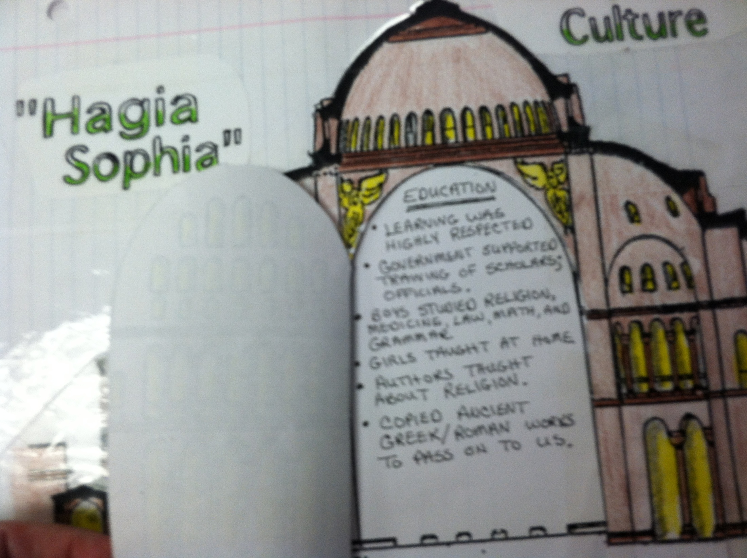

Slide 7
Art and Architecture
Supported Artists & Architects
Ordered the Building of Churches, Forts & Public Buildings
Known for its Churches, and Palaces
Hagia Sophia
Walls of Marble
Mosiacs

Slide 8
