Slide 1
Ghana, Mali, Songhai, Benin & Kongo, Zimbabwe, & Axum
Mrs. Tucker
7th Grade World History/Honors
Cobalt Institute of Math and Science

Slide 2
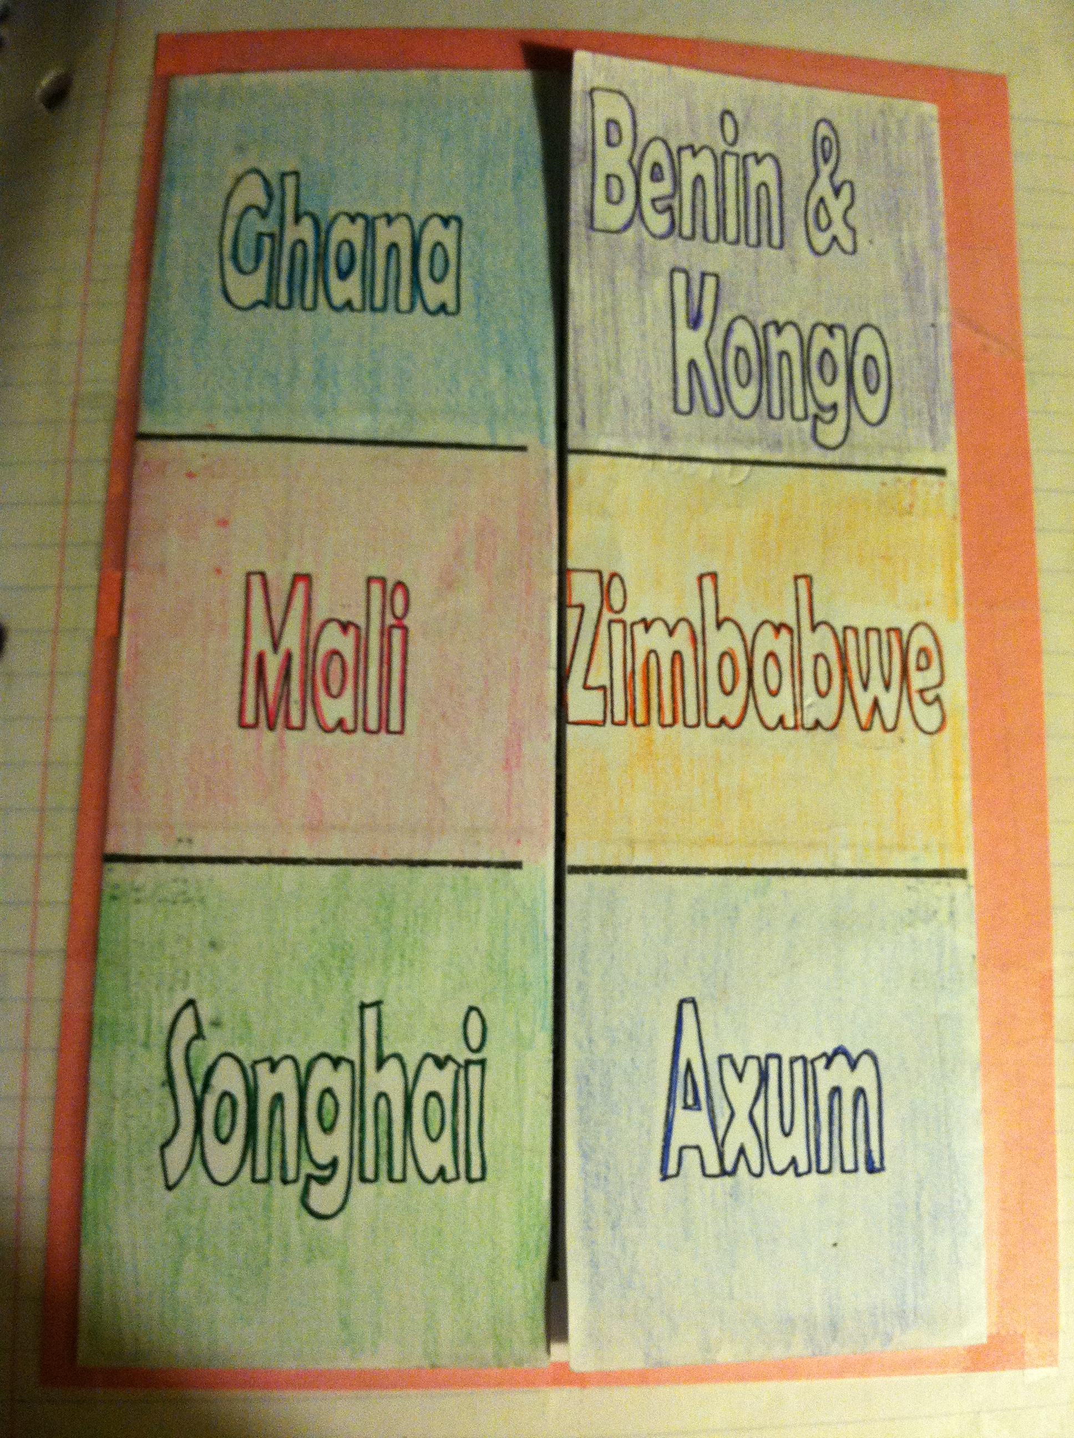

Slide 3
Ghana and Benin & Kongo
Ghana
Accomplishments
Iron Weapons
Control of Gold Mines
Huge Army
Wealth from trade and taxes
Benin & Kongo
Accomplishments
Grew a surplus of foods to trade for needed supplies

Slide 4
Mali and Zimbabwe
Mali
Accomplishments:
Conquests of land
Control of gold mines
Rebuilt the gold/salt trade
Zimbabwe
Accomplishments:
Wealth from trading
Large stone capital
Inland Empire

Slide 5
Songhai and Axum
Songhai
Accomplishments:
Control of the Niger River
Control of the Salt Mines
Conquests of Land in West Africa
Axum
Accomplishments:
Controlled the trade routes
Defeated the Kush

