Slide 1
Five Pillars of Islam
Mrs. Tucker
7th Grade Social Studies/Honors
Cobalt Institute of Math and Science

Slide 2
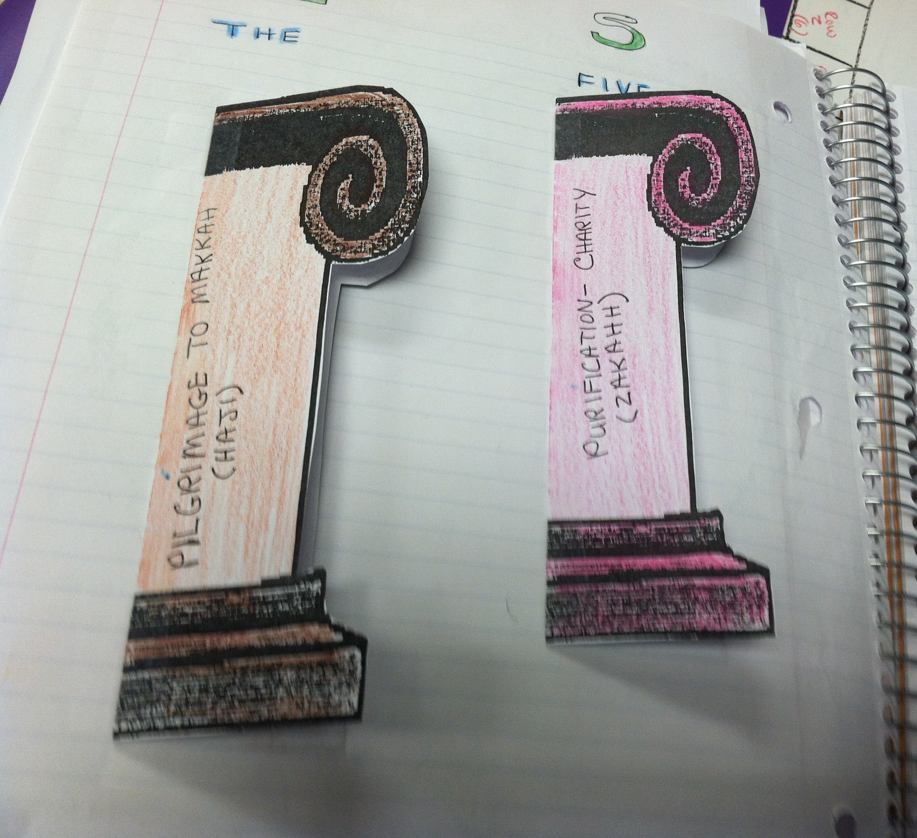
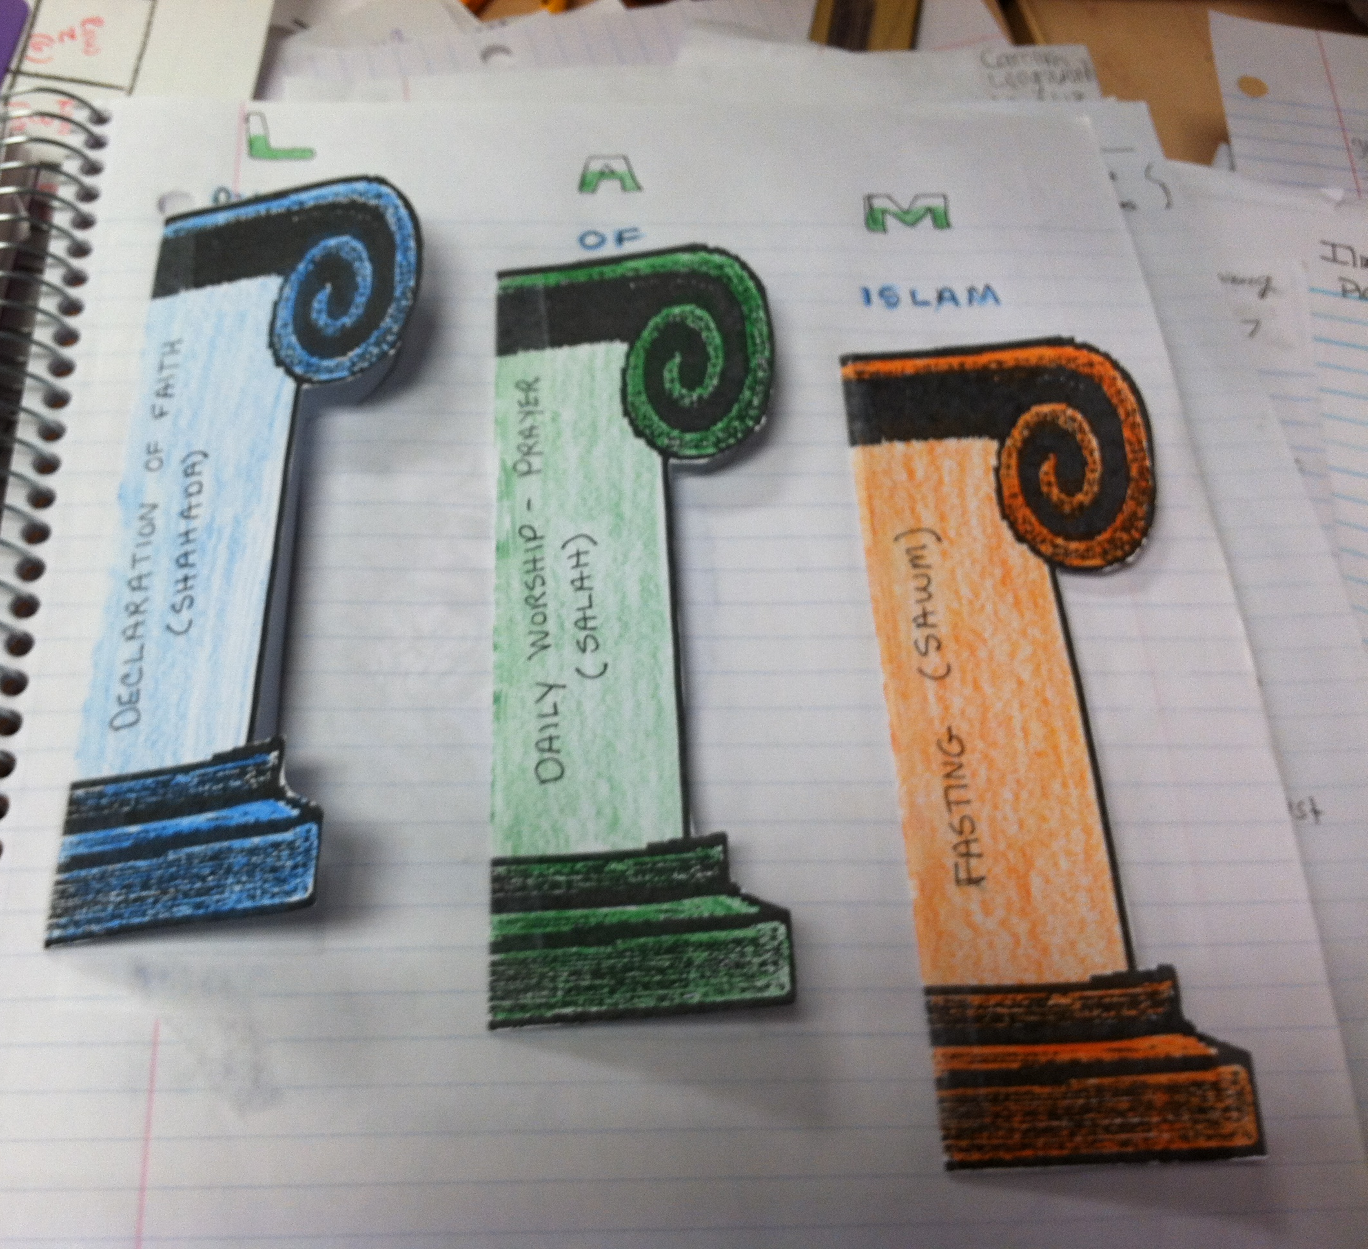
The Five Pillars of Islam

Slide 3
Pillar 1 – Declaration of Faith (Shahada)
Outside:
Declaration of Faith (Shahada)
Inside:
The Belief that there is no God but Allah and Muhammad is his prophet.

Slide 4
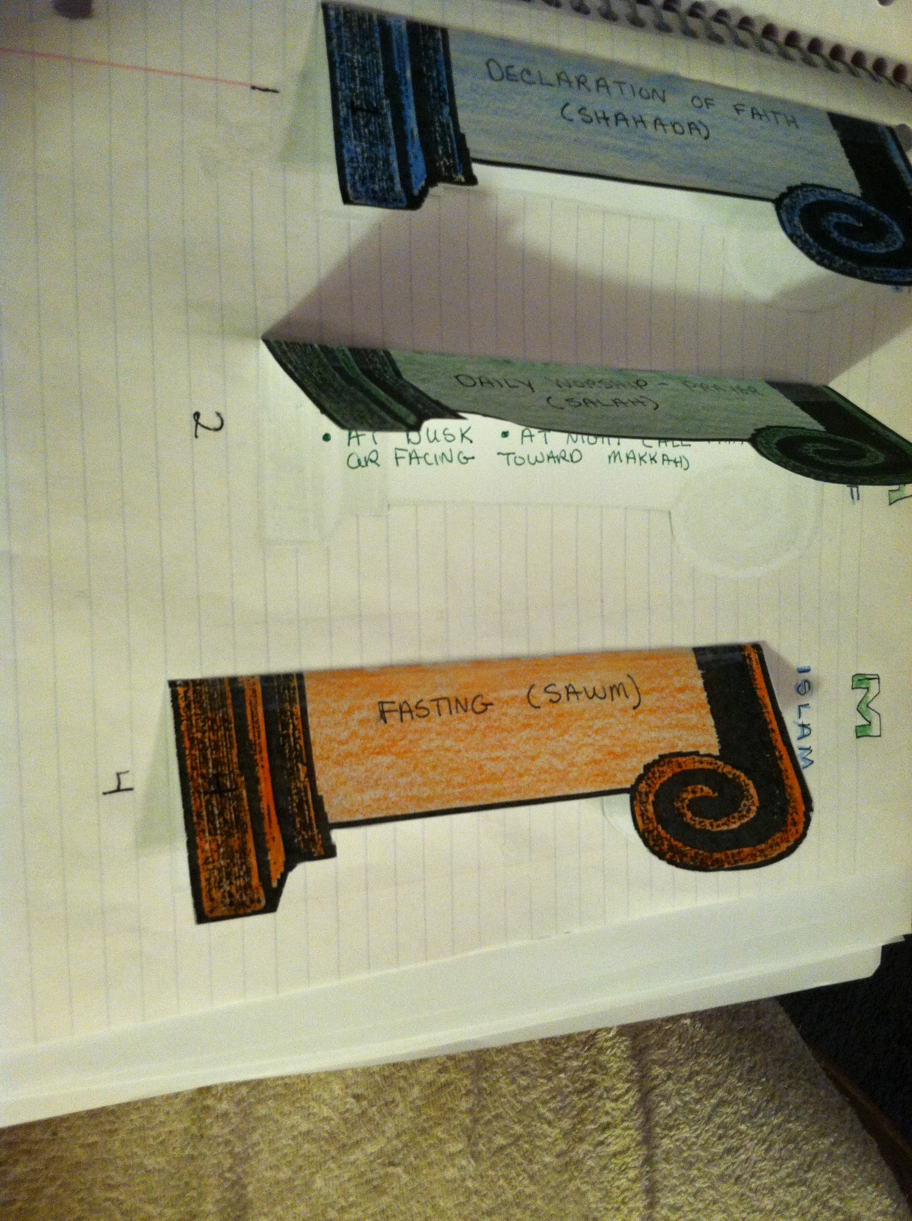
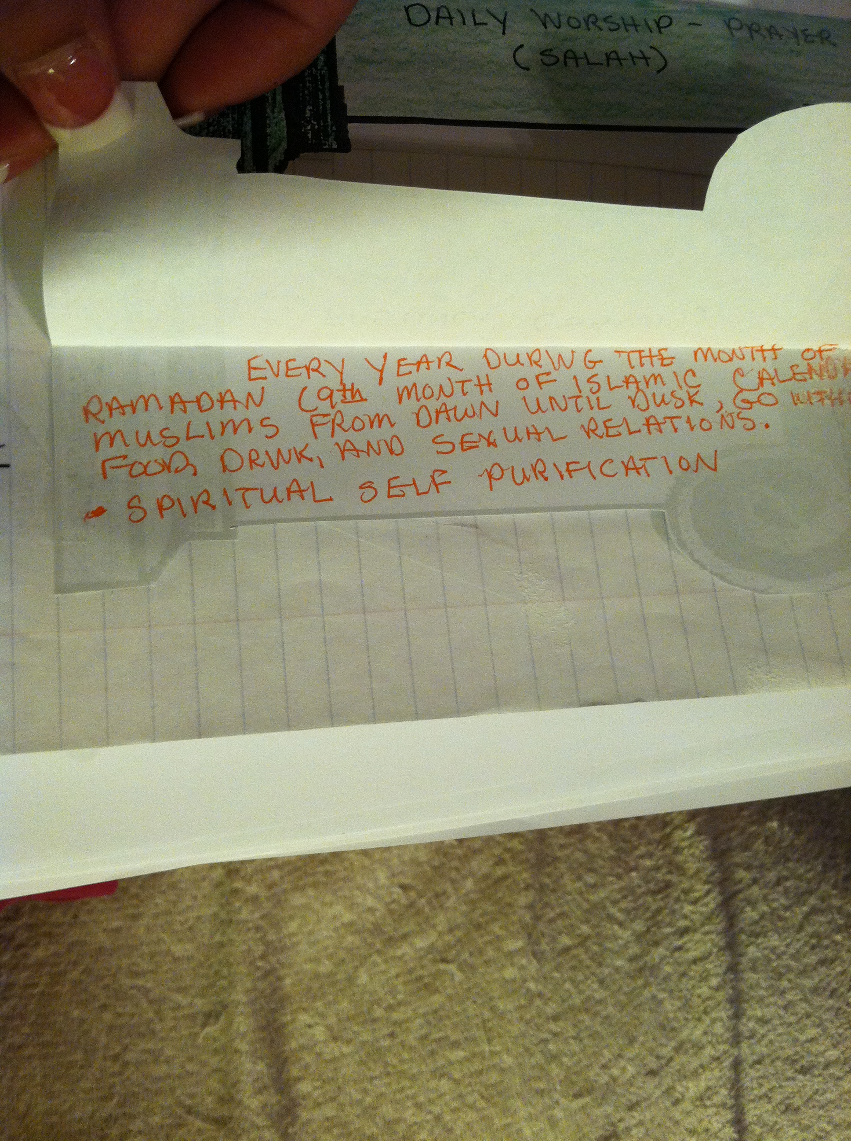
First Pillar

Slide 5
Pillar 2 - Daily Worship – Prayer (Salah)
Outside:
Daily Worship – Prayer (Salah)
Inside:
Muslims Pray 5 Times a Day
At Dawn
Midday
In the Afternoon
At Dusk
At Night
(All Prayers are Facing Toward Makkah)

Slide 6
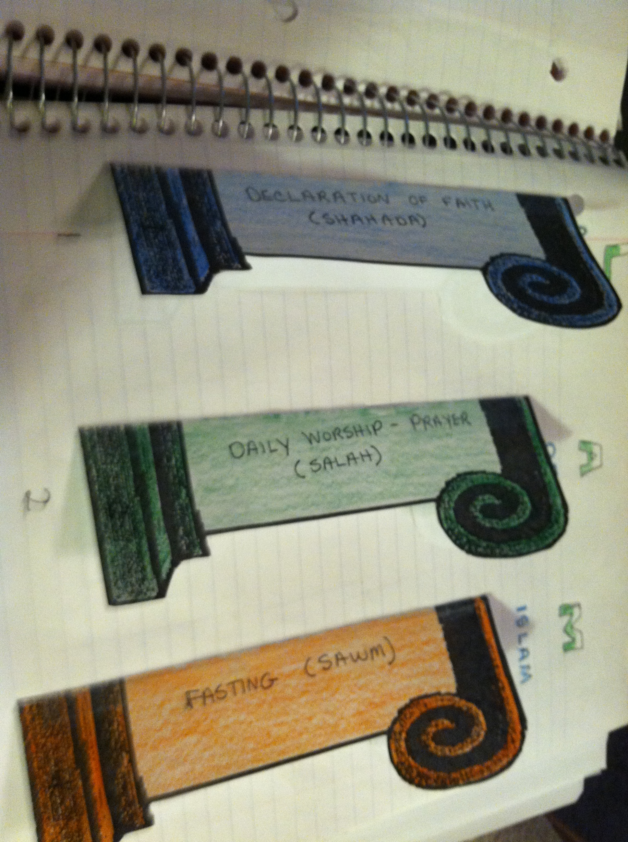
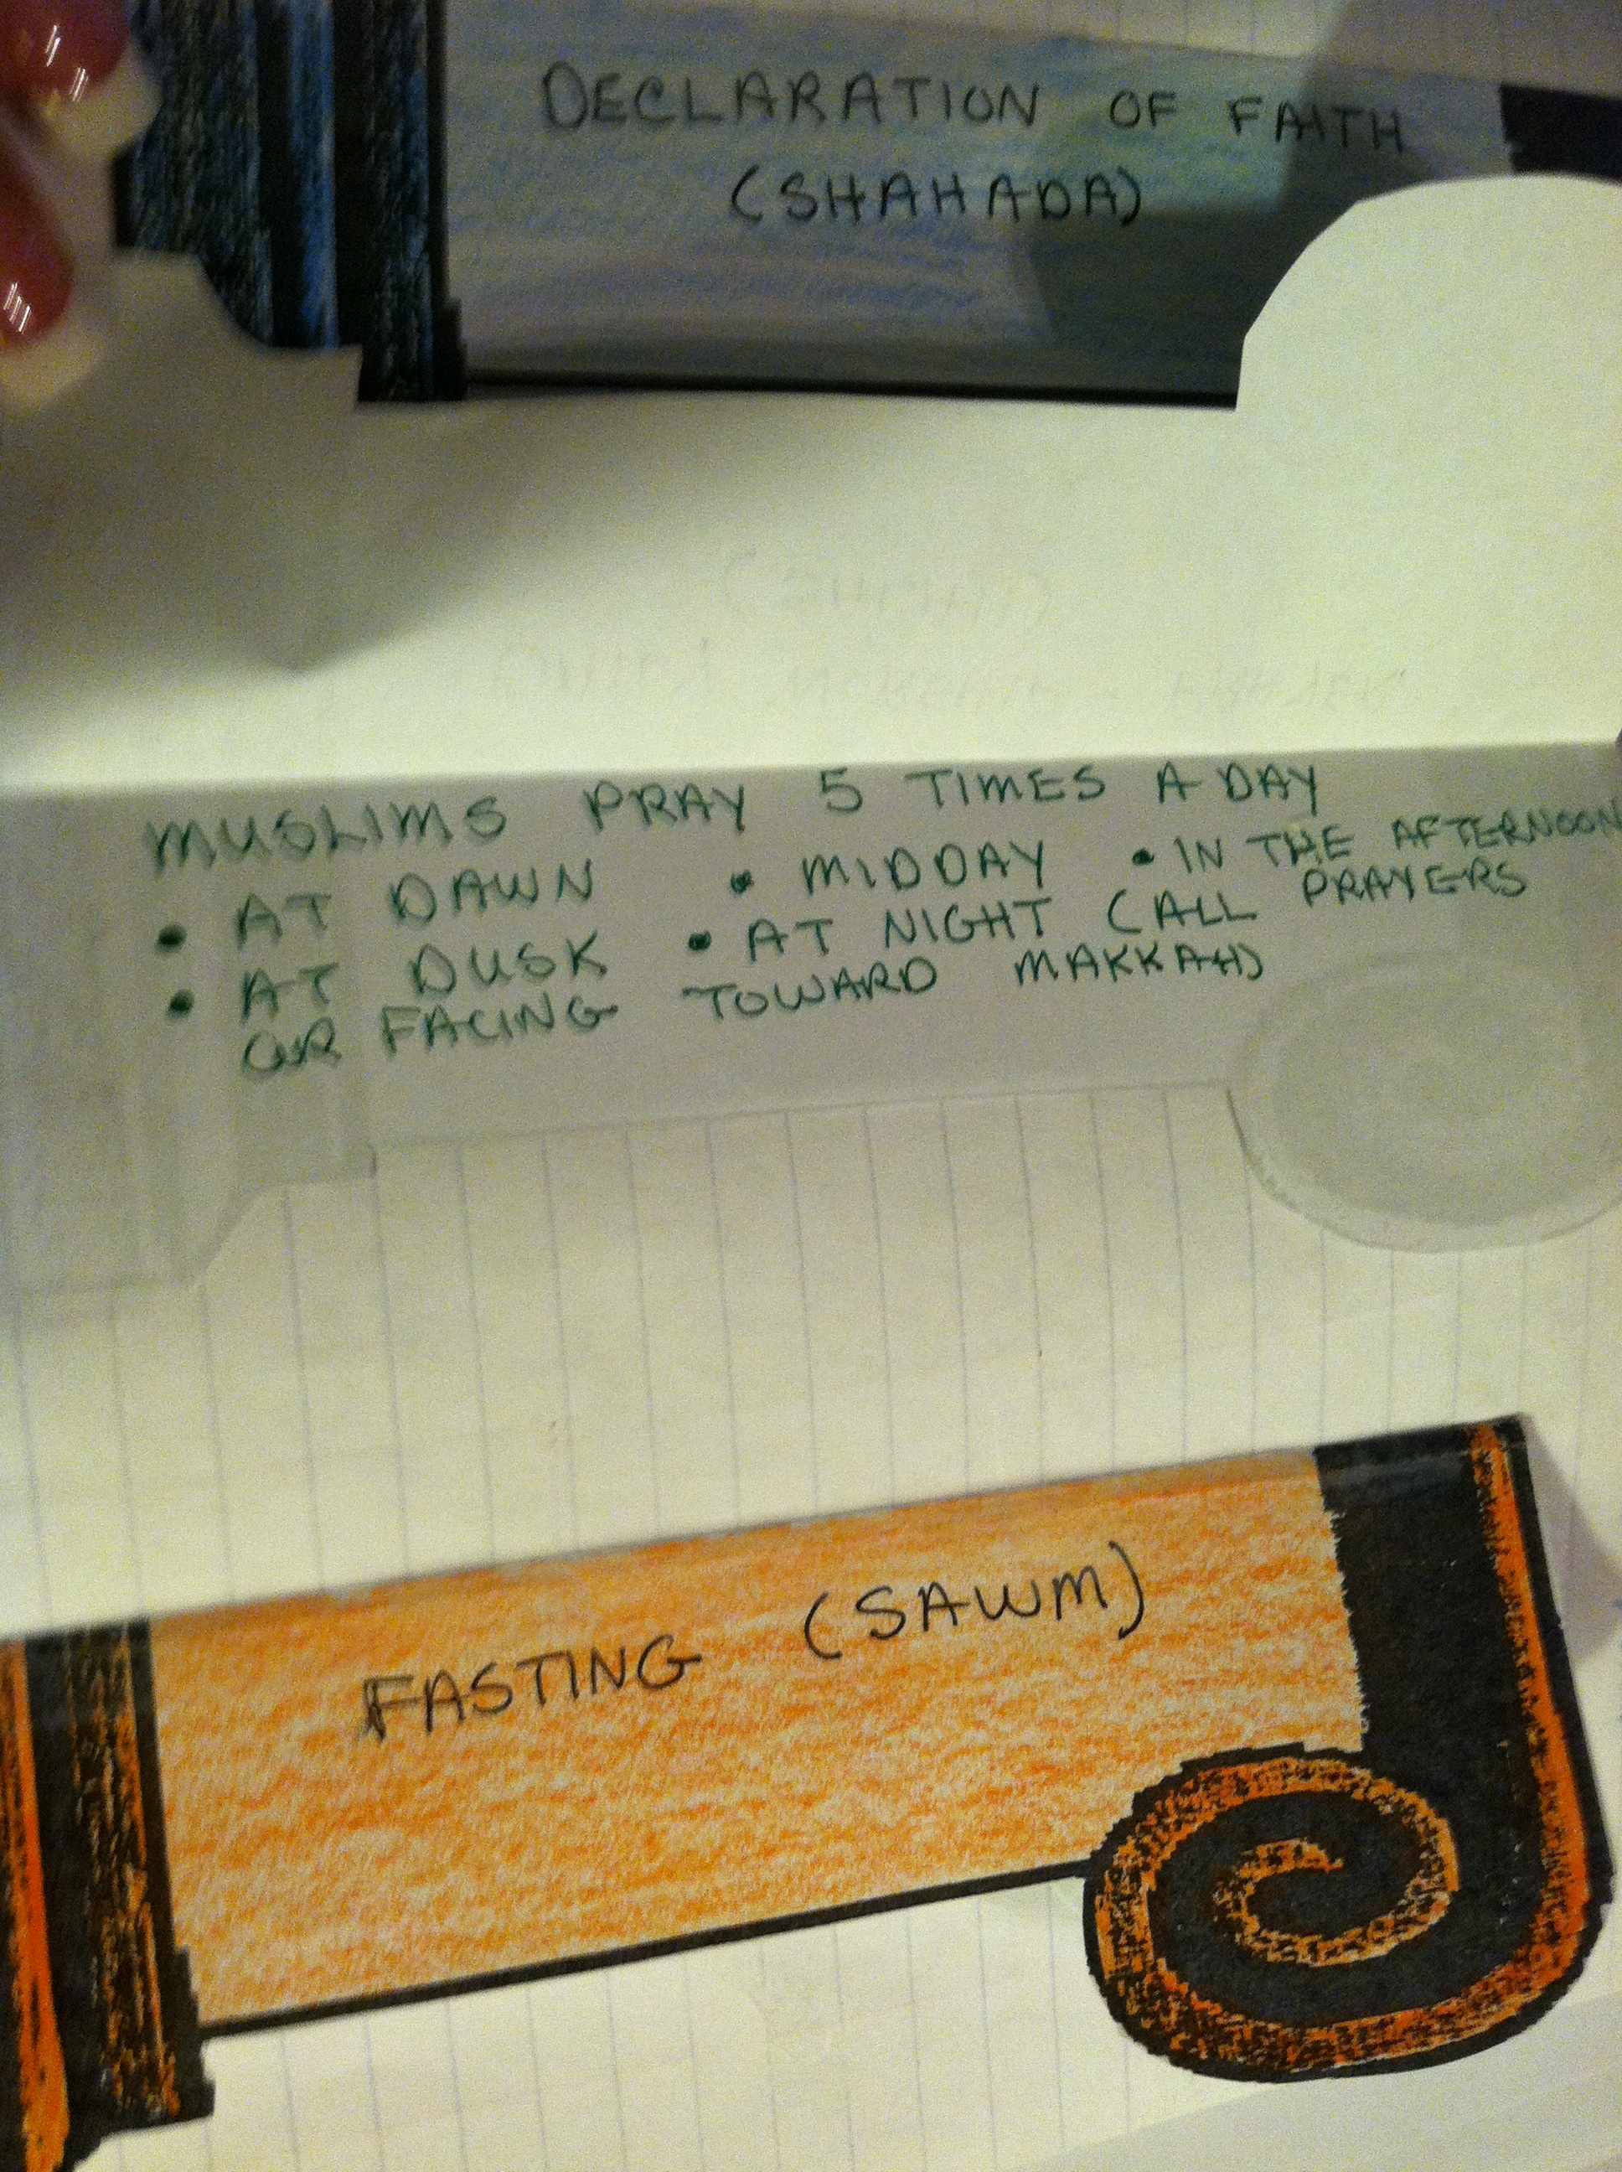
2nd Pillar

Slide 7
Pillar 3 – Purification – Charity (Zakahh)
Outside:
Purification – Charity (Zakahh)
Inside:
Requires Muslims to purify their wealth by giving a percentage of their assets to the needy. Reminds them all things come from God.

Slide 8
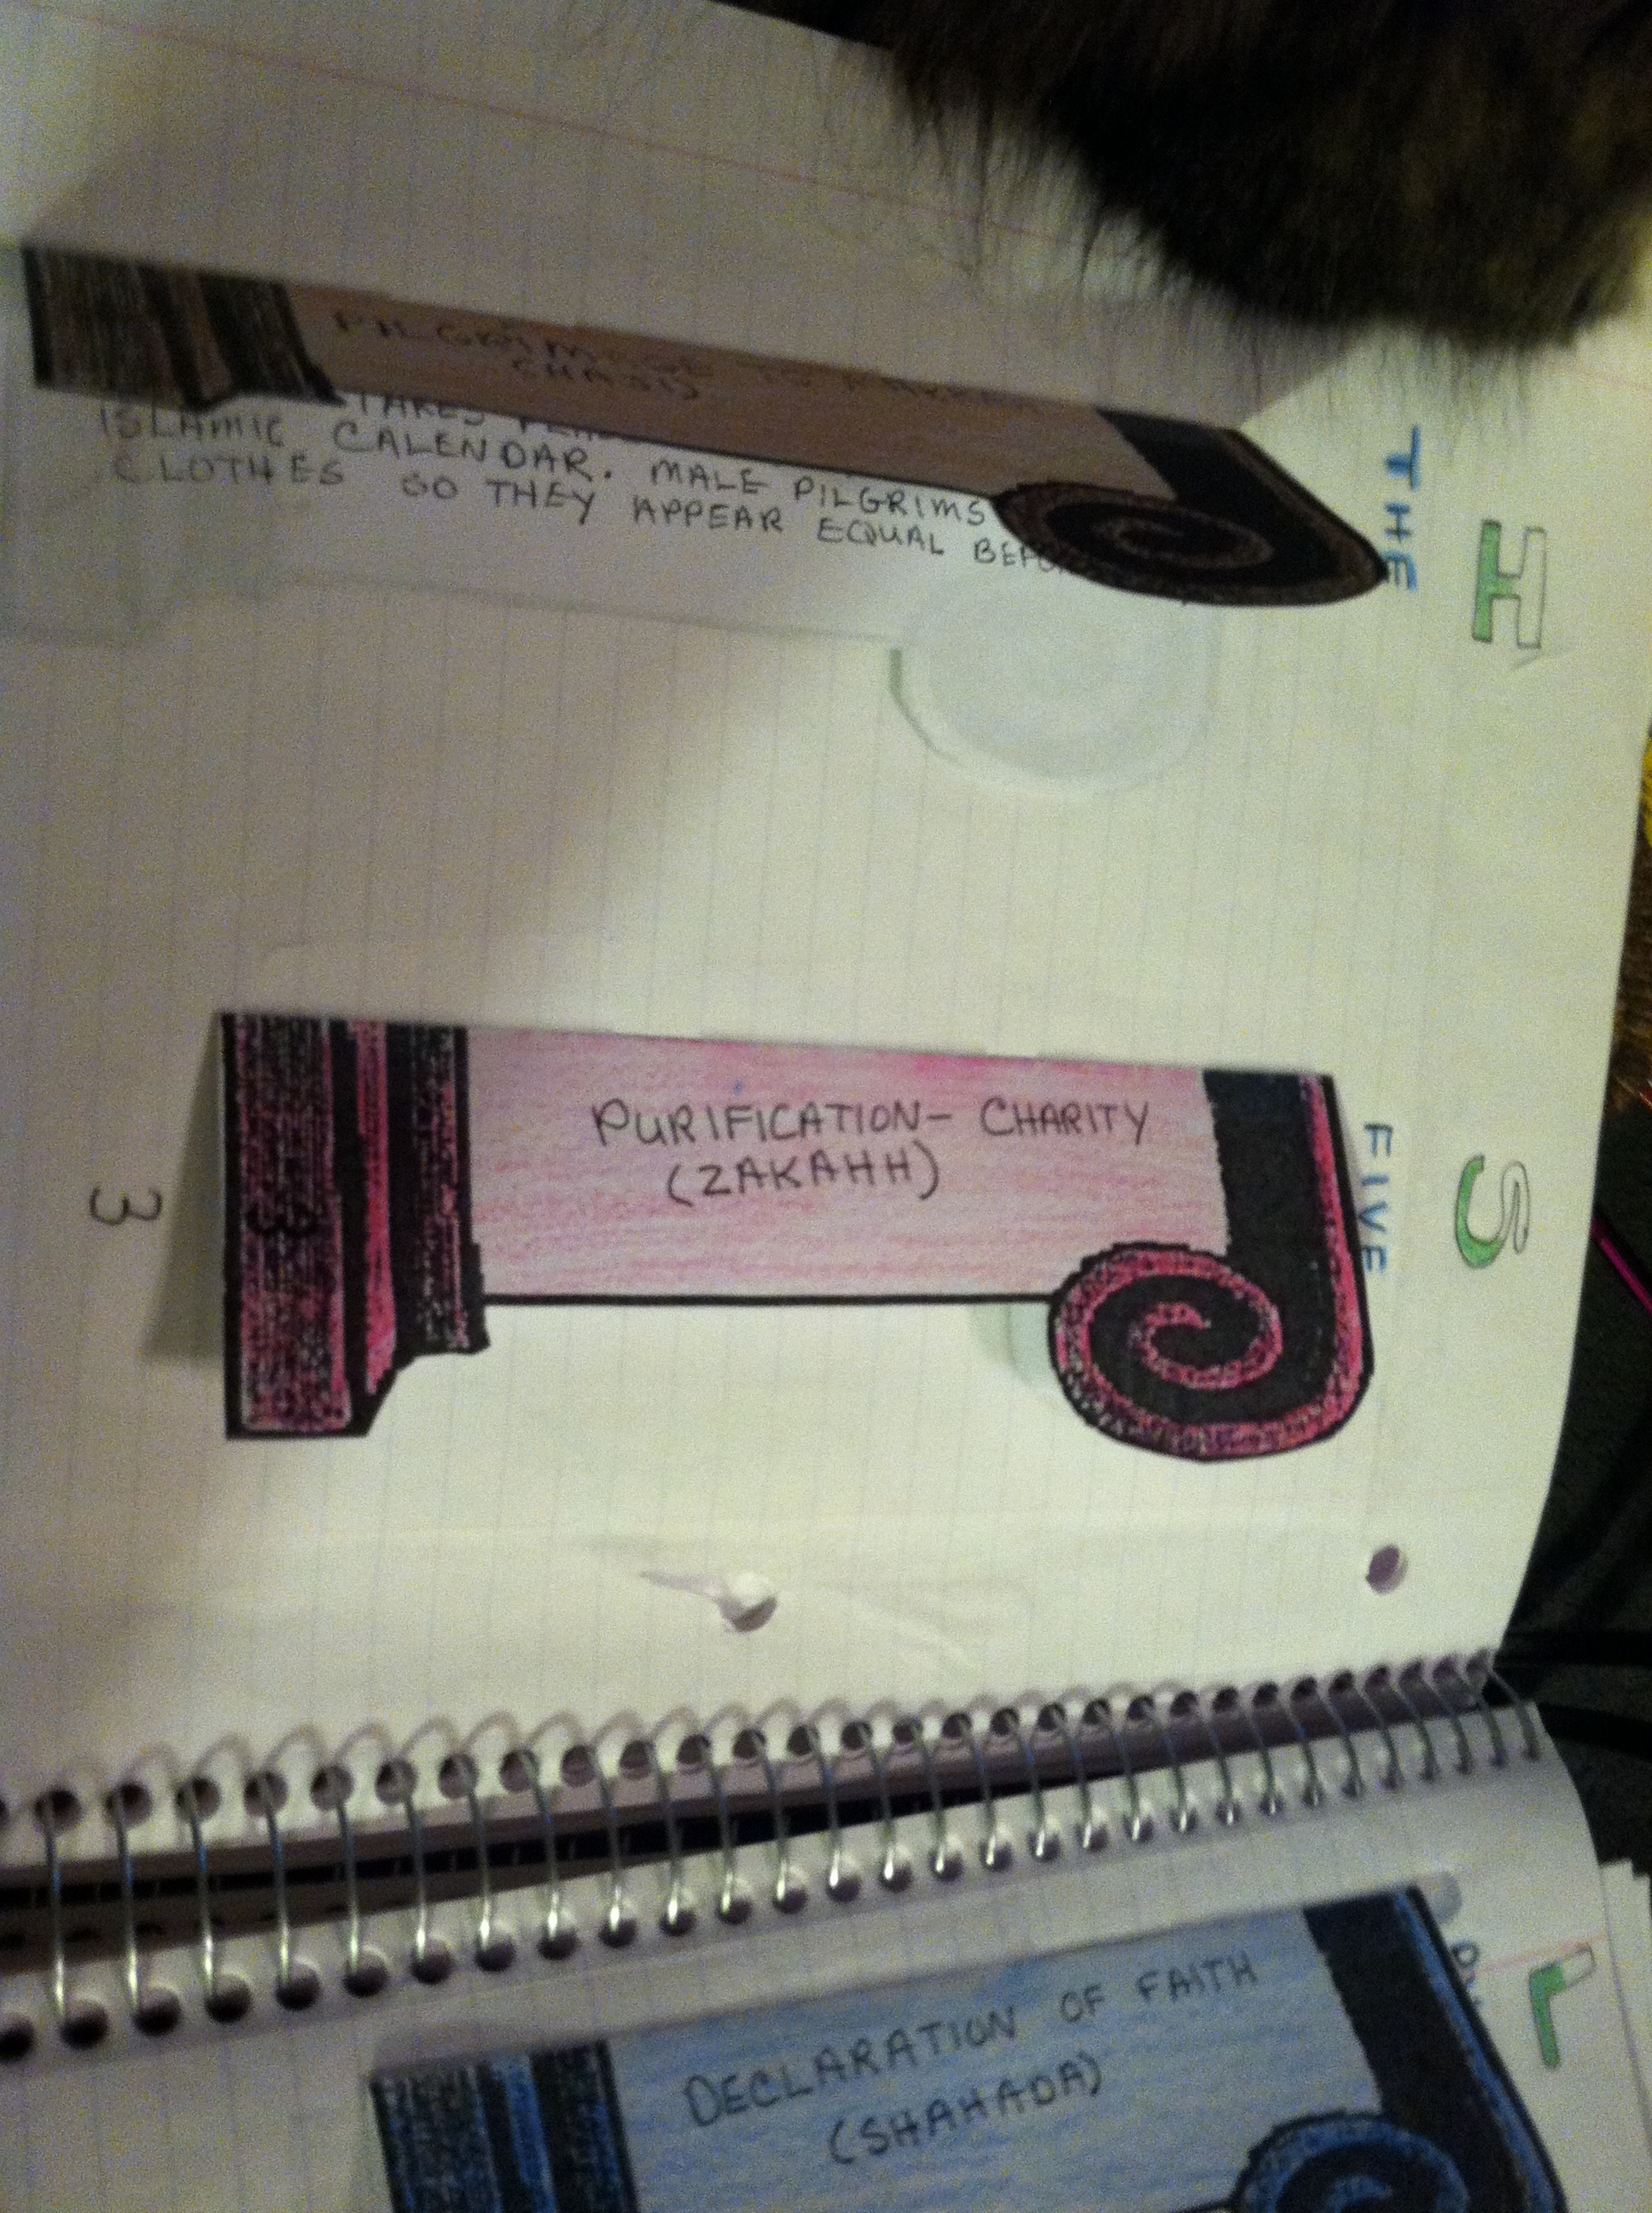
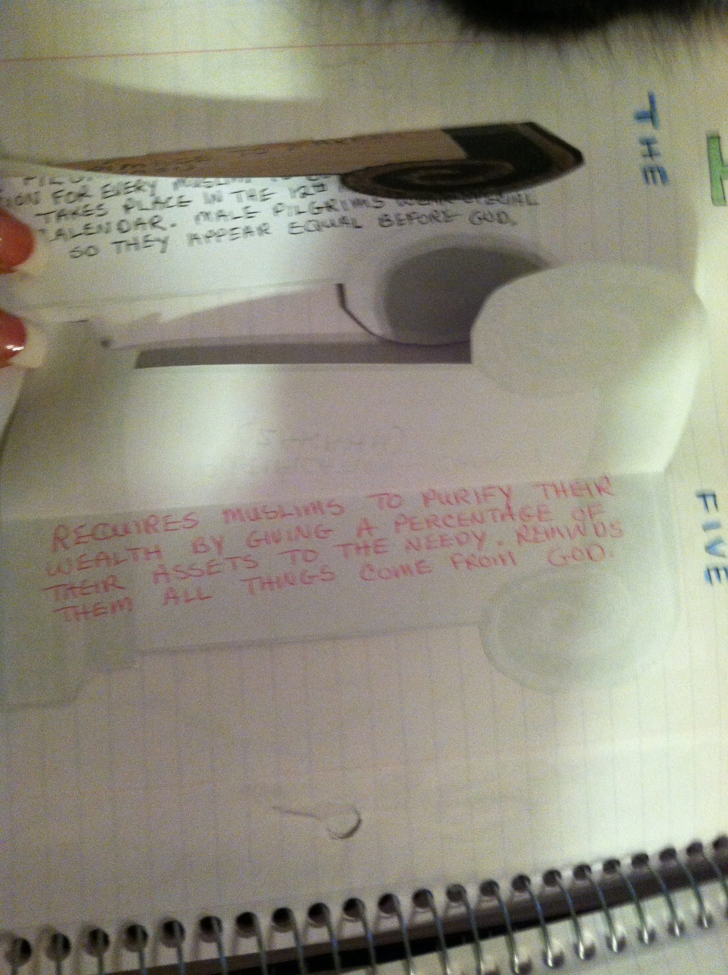
3rd Pillar

Slide 9
Pillar 4 – Fasting (SAWM)
Outside:
Fasting (SAWM)
Inside:
Every year during the month of Ramadan (9th month of Islamic Calendar) Muslims from dawn until dusk, go without food, drink, and sexual relations.
Spiritual Self Purification

Slide 10
4th Pillar

Slide 11
Pillar 5 – Pilgrimage to Makkah (Haji)
Outside:
Pilgrimage to Makkah (Haji)
Inside:
Annual pilgrimage to Makkah is an obligation for every Muslim to do once in his/her lifetime. Takes place in the 12th month of the Islamic Calendar. Male pilgrims wear special clothes so they appear equal before God.

Slide 12
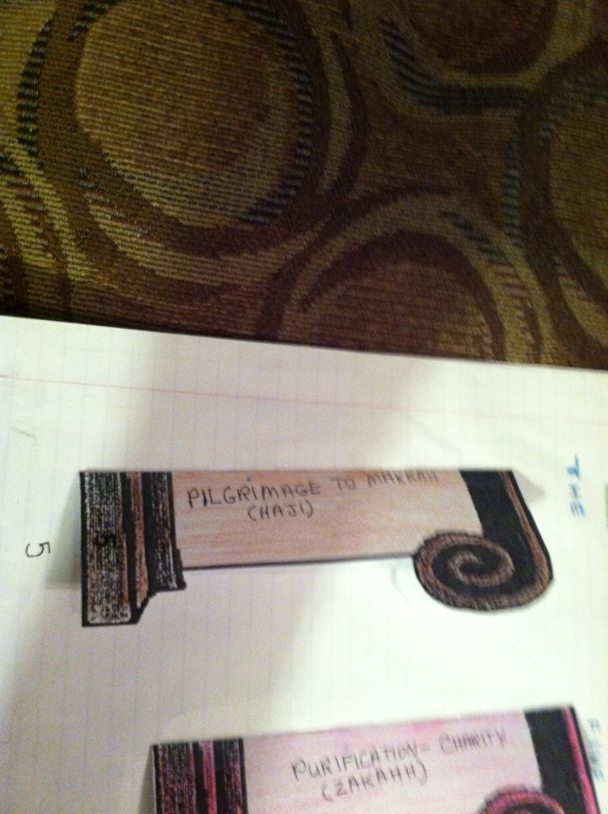
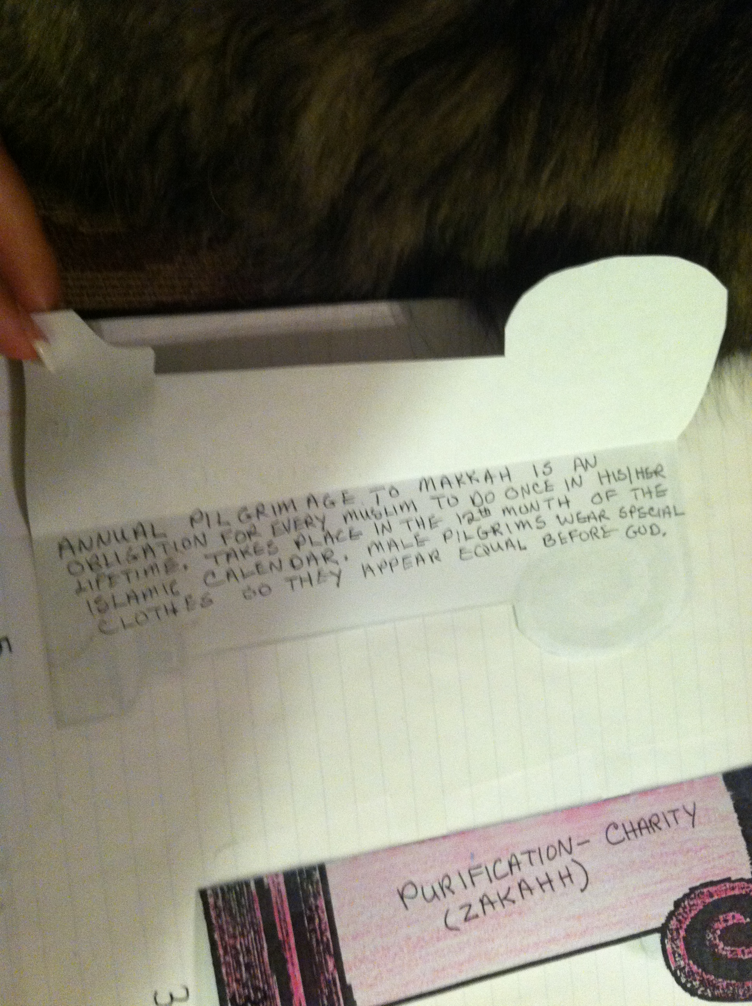
5th Pillar

