Slide 1
The Disintegration of the Roman Empire (284 C.E. – 476 C.E.)
Mrs. Tucker
7th Grade World History Honors
Cobalt Institute of Math and Science

Slide 2
Complete the Time Line
Fill in the squares with the dates going from oldest to newest.
Color the squares different colors when you are finished.
Tape the timeline in your interactive notebook

Slide 3
284 C.E.
Diocletian Becomes Emperor of the Roman Empire

Slide 4
330 C.E.
Constantine Moves Capital to Constantinople

Slide 5
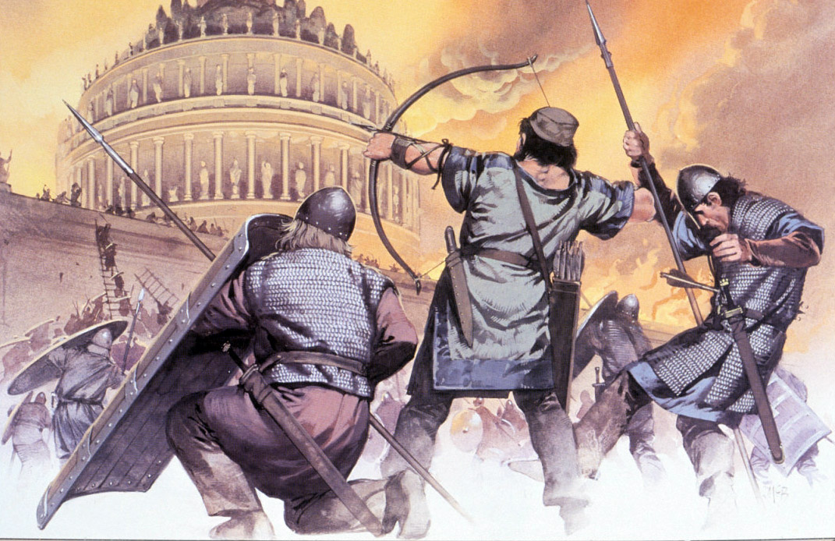

Slide 6
378 C.E.
The Germanic Visigoths Defeat the Romans

Slide 7
395 C.E.
The Emperor Theodosius Dies

Slide 8
395 C.E.
The Roman Empire Splits in Two

Slide 9
410 C.E.
Alaric and the Visigoths Capture Rome

Slide 10
455 C.E.
The Germanic Vandals Invade Rome

Slide 11
476 C.E.
The Last Western Emperor is Overthrown

