Slide 1
Desert, Savannah, Rainforest, Mediterranean
Mrs. Tucker
7th Grade World History/Honors
Cobalt Institute of Math and Science

Slide 2
Desert Savannah
A landscape or region that receives an extremely low amount of precipitation.
Less than enough rainfall to support growth of most plants
Most deserts have an average annual precipitation of less than 16 inches
The open canopy allows sufficient light to reach the ground
Common definition is basically a grassy woodland with a significant woody plant components

Slide 3
Rainforest Mediterranean
Are forests characterized by high rainfall.
With definitions based on minimum normal rainfall of 68 – 78 inches (which is about 6 ½ feet)
Climate characterized by warm to hot, dry summers and mild to cool, wet winters

Slide 4
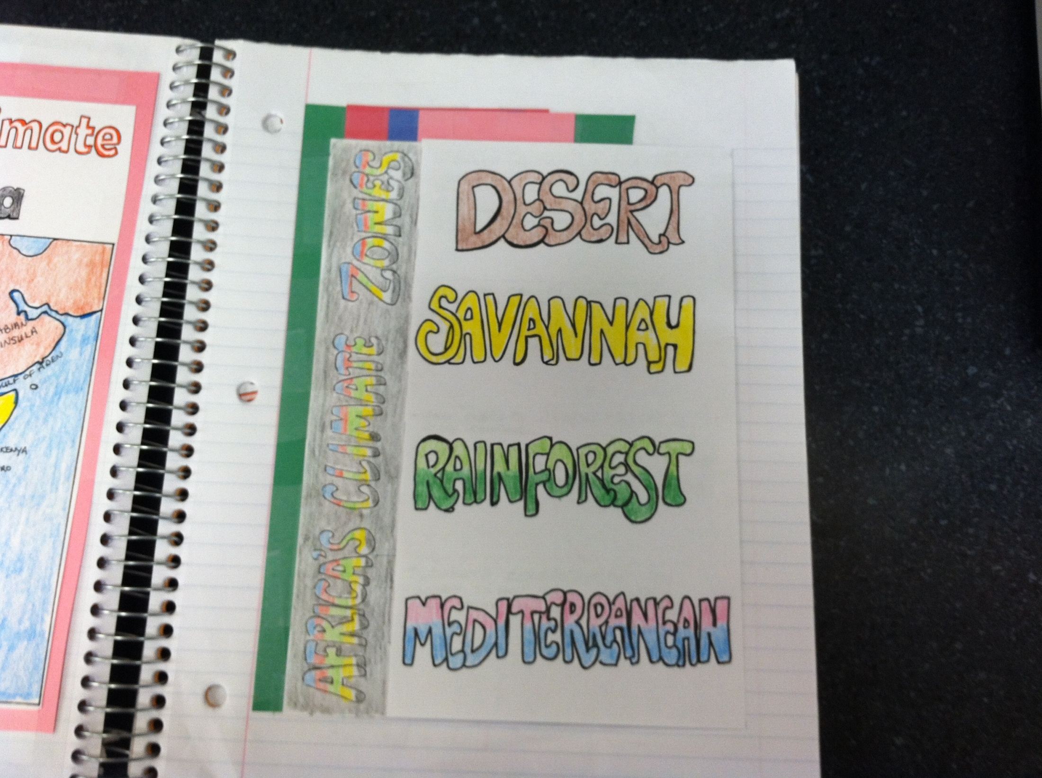

Slide 5
