Slide 1
Arabian Peninsula
Mrs. Tucker
7th Grade World History/Honors
Cobalt Institute of Math and Science

Slide 2
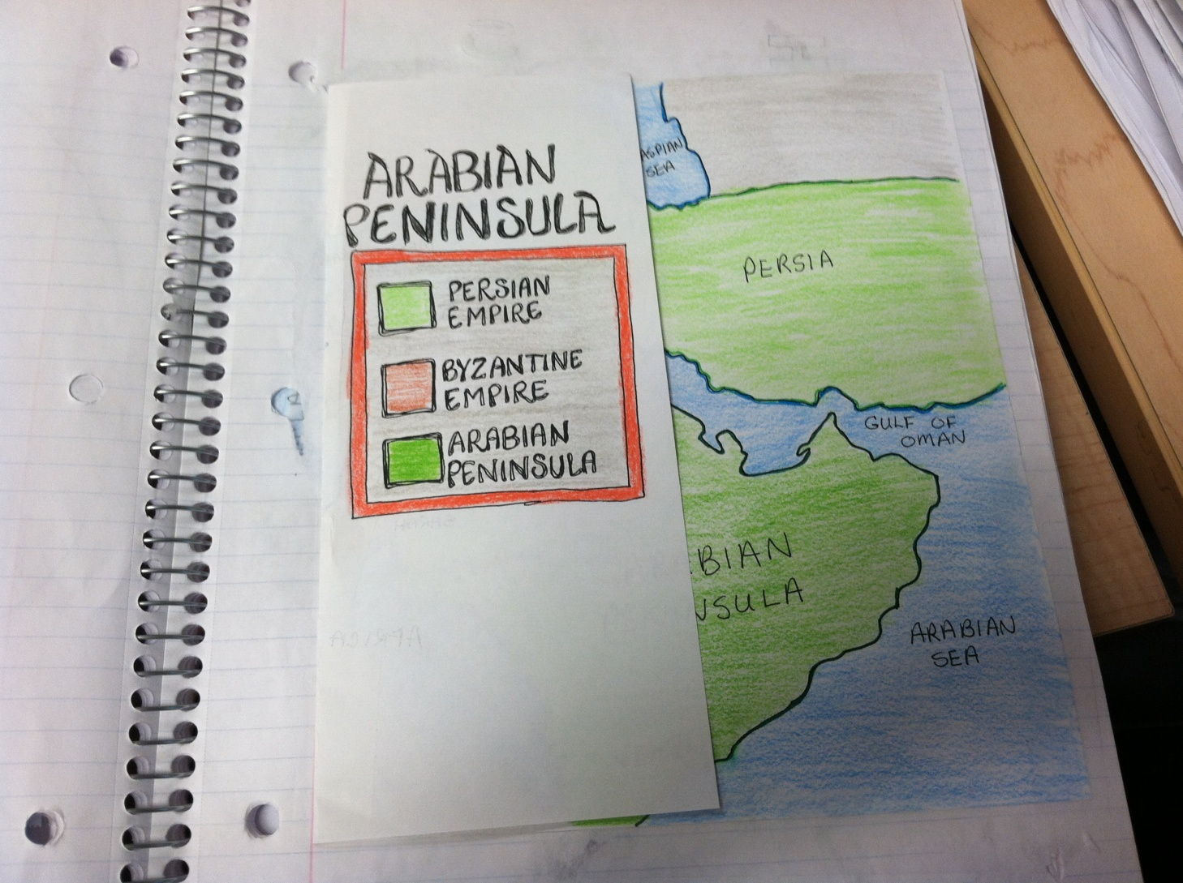
Arabian Peninsula - Key

Slide 3
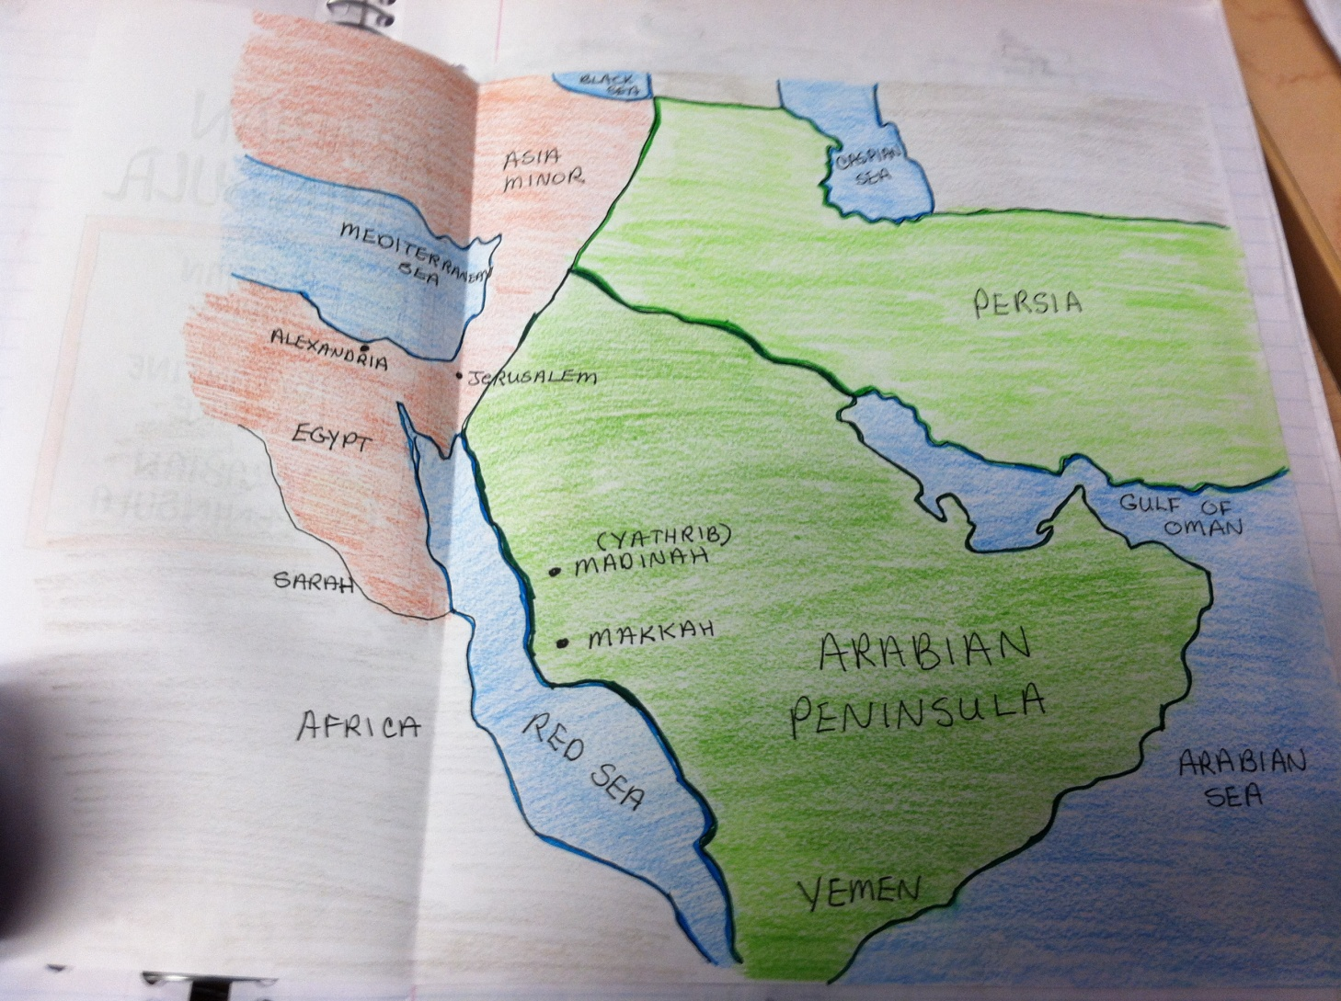
Arabian Peninsula

