Slide 1
African Vocabulary Booklet
Mrs. Tucker
7th Grade World History/Honors
Cobalt Institute of Math and Science

Slide 2
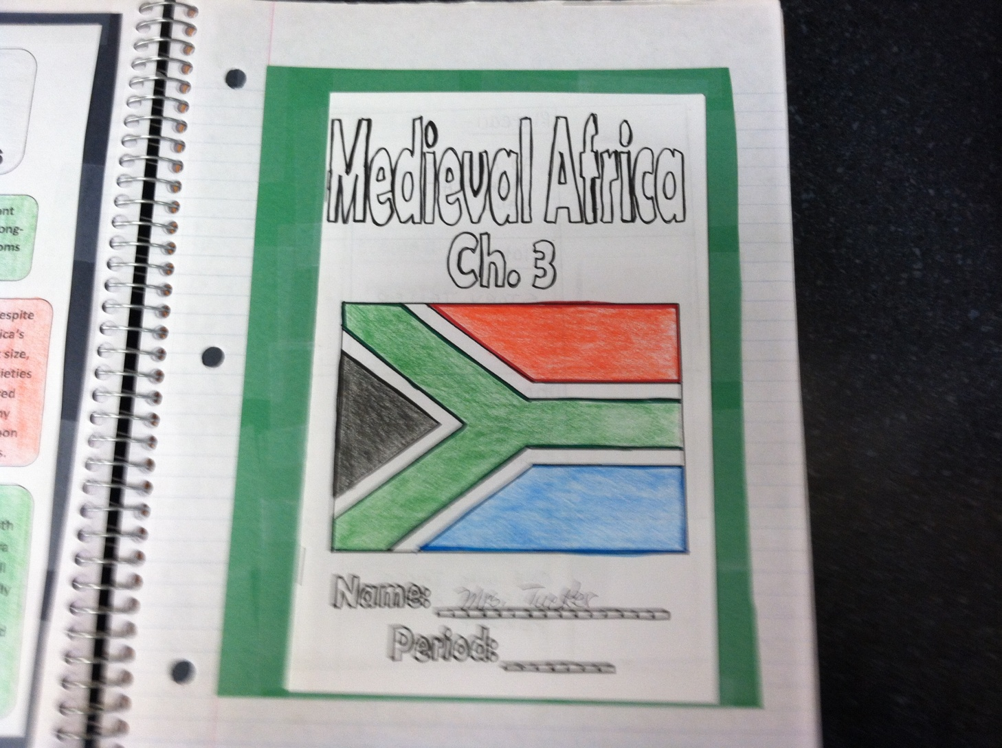
Definitions inText, Chapter 3, page 206

Slide 3
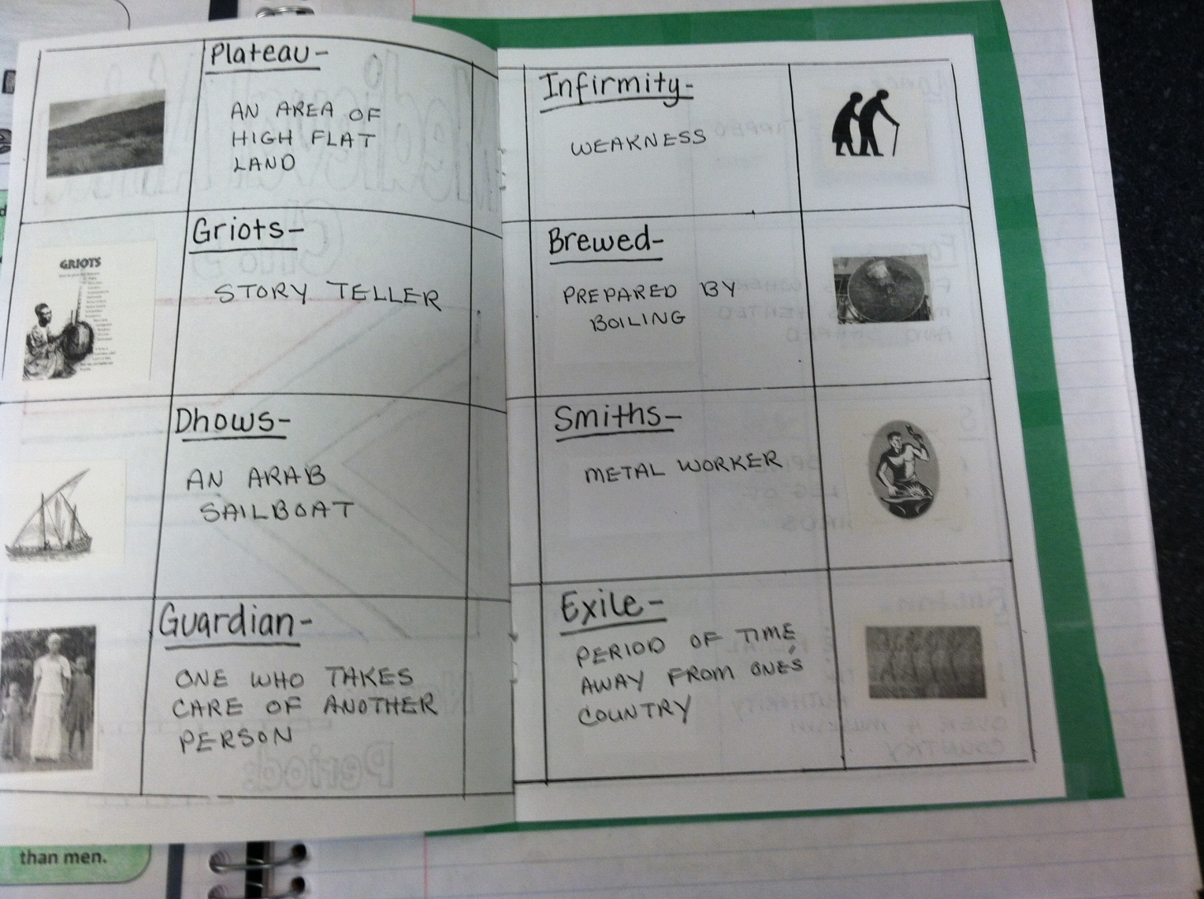

Slide 4
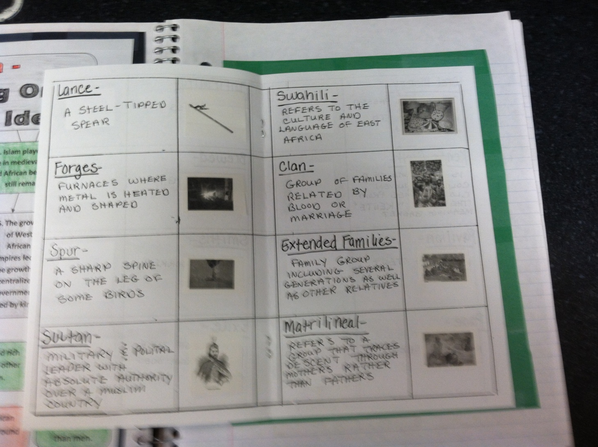

Slide 5
