Slide 1
African Religions Today
Mrs. Tucker
7th Grade World History Honors
Cobalt Institute of Math and Science

Slide 2
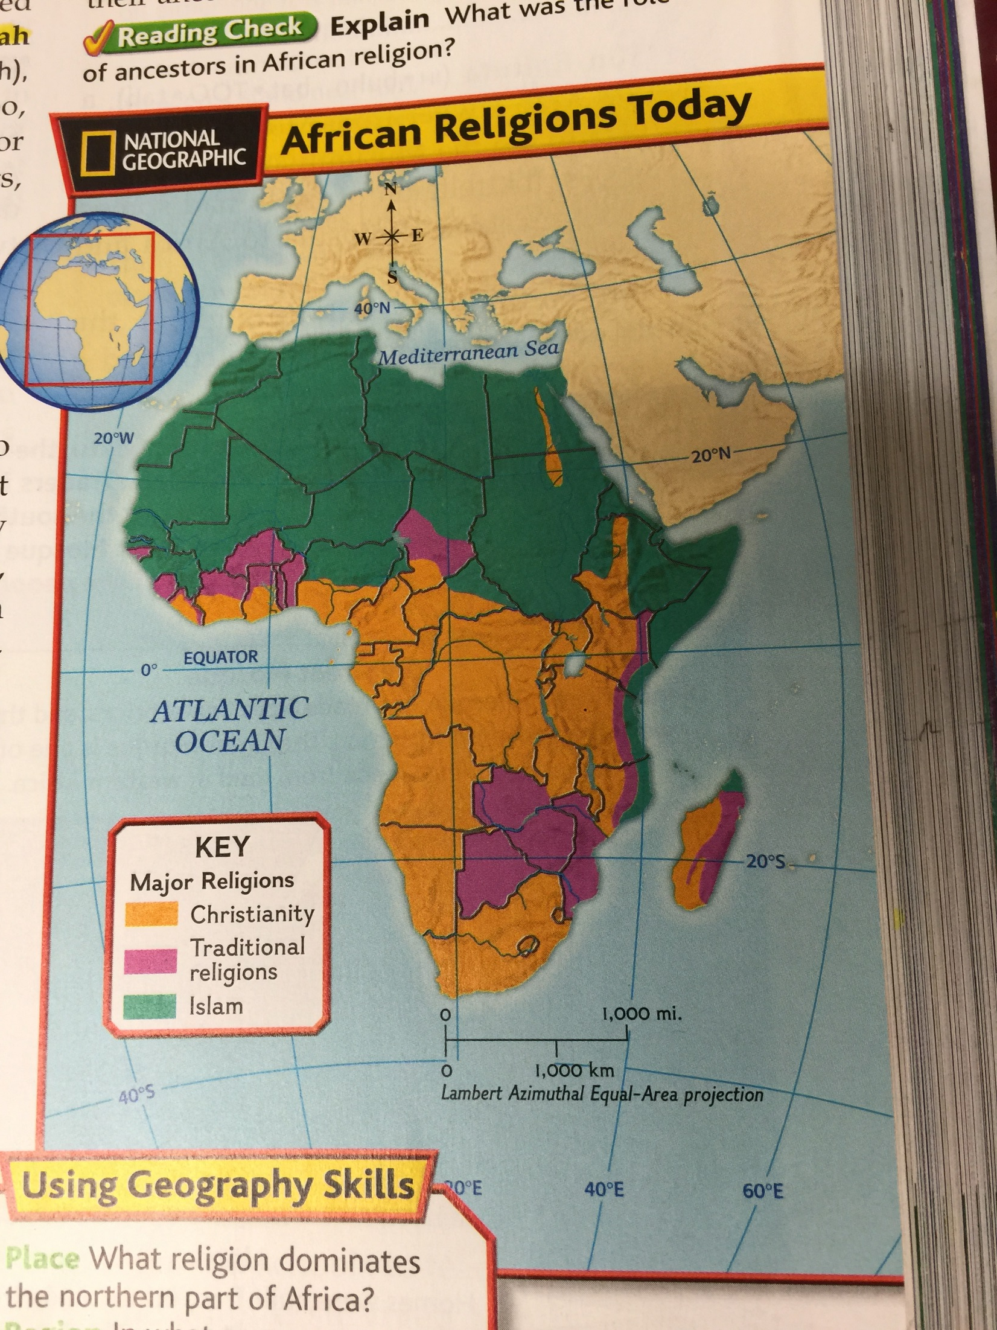

Slide 3
